Slide 1



Documentation for the Preservation of Cultural Landscape of Cave Valley,
Casas Grandes, Chihuahua
23rd Biennial Jornada Mogollon Conference at El Paso Museum of Archaeology
Yuko Kita¹, Sergio Alvarado-Soto², Angélica Nohemí Chávez-Martínez¹
Departamento de Arquitectura, Instituto de Arquitectura, Diseño y Arte
Departamento de Ingeniería Civil y Ambiental, Instituto de Ingeniería y Tecnología

Slide 2
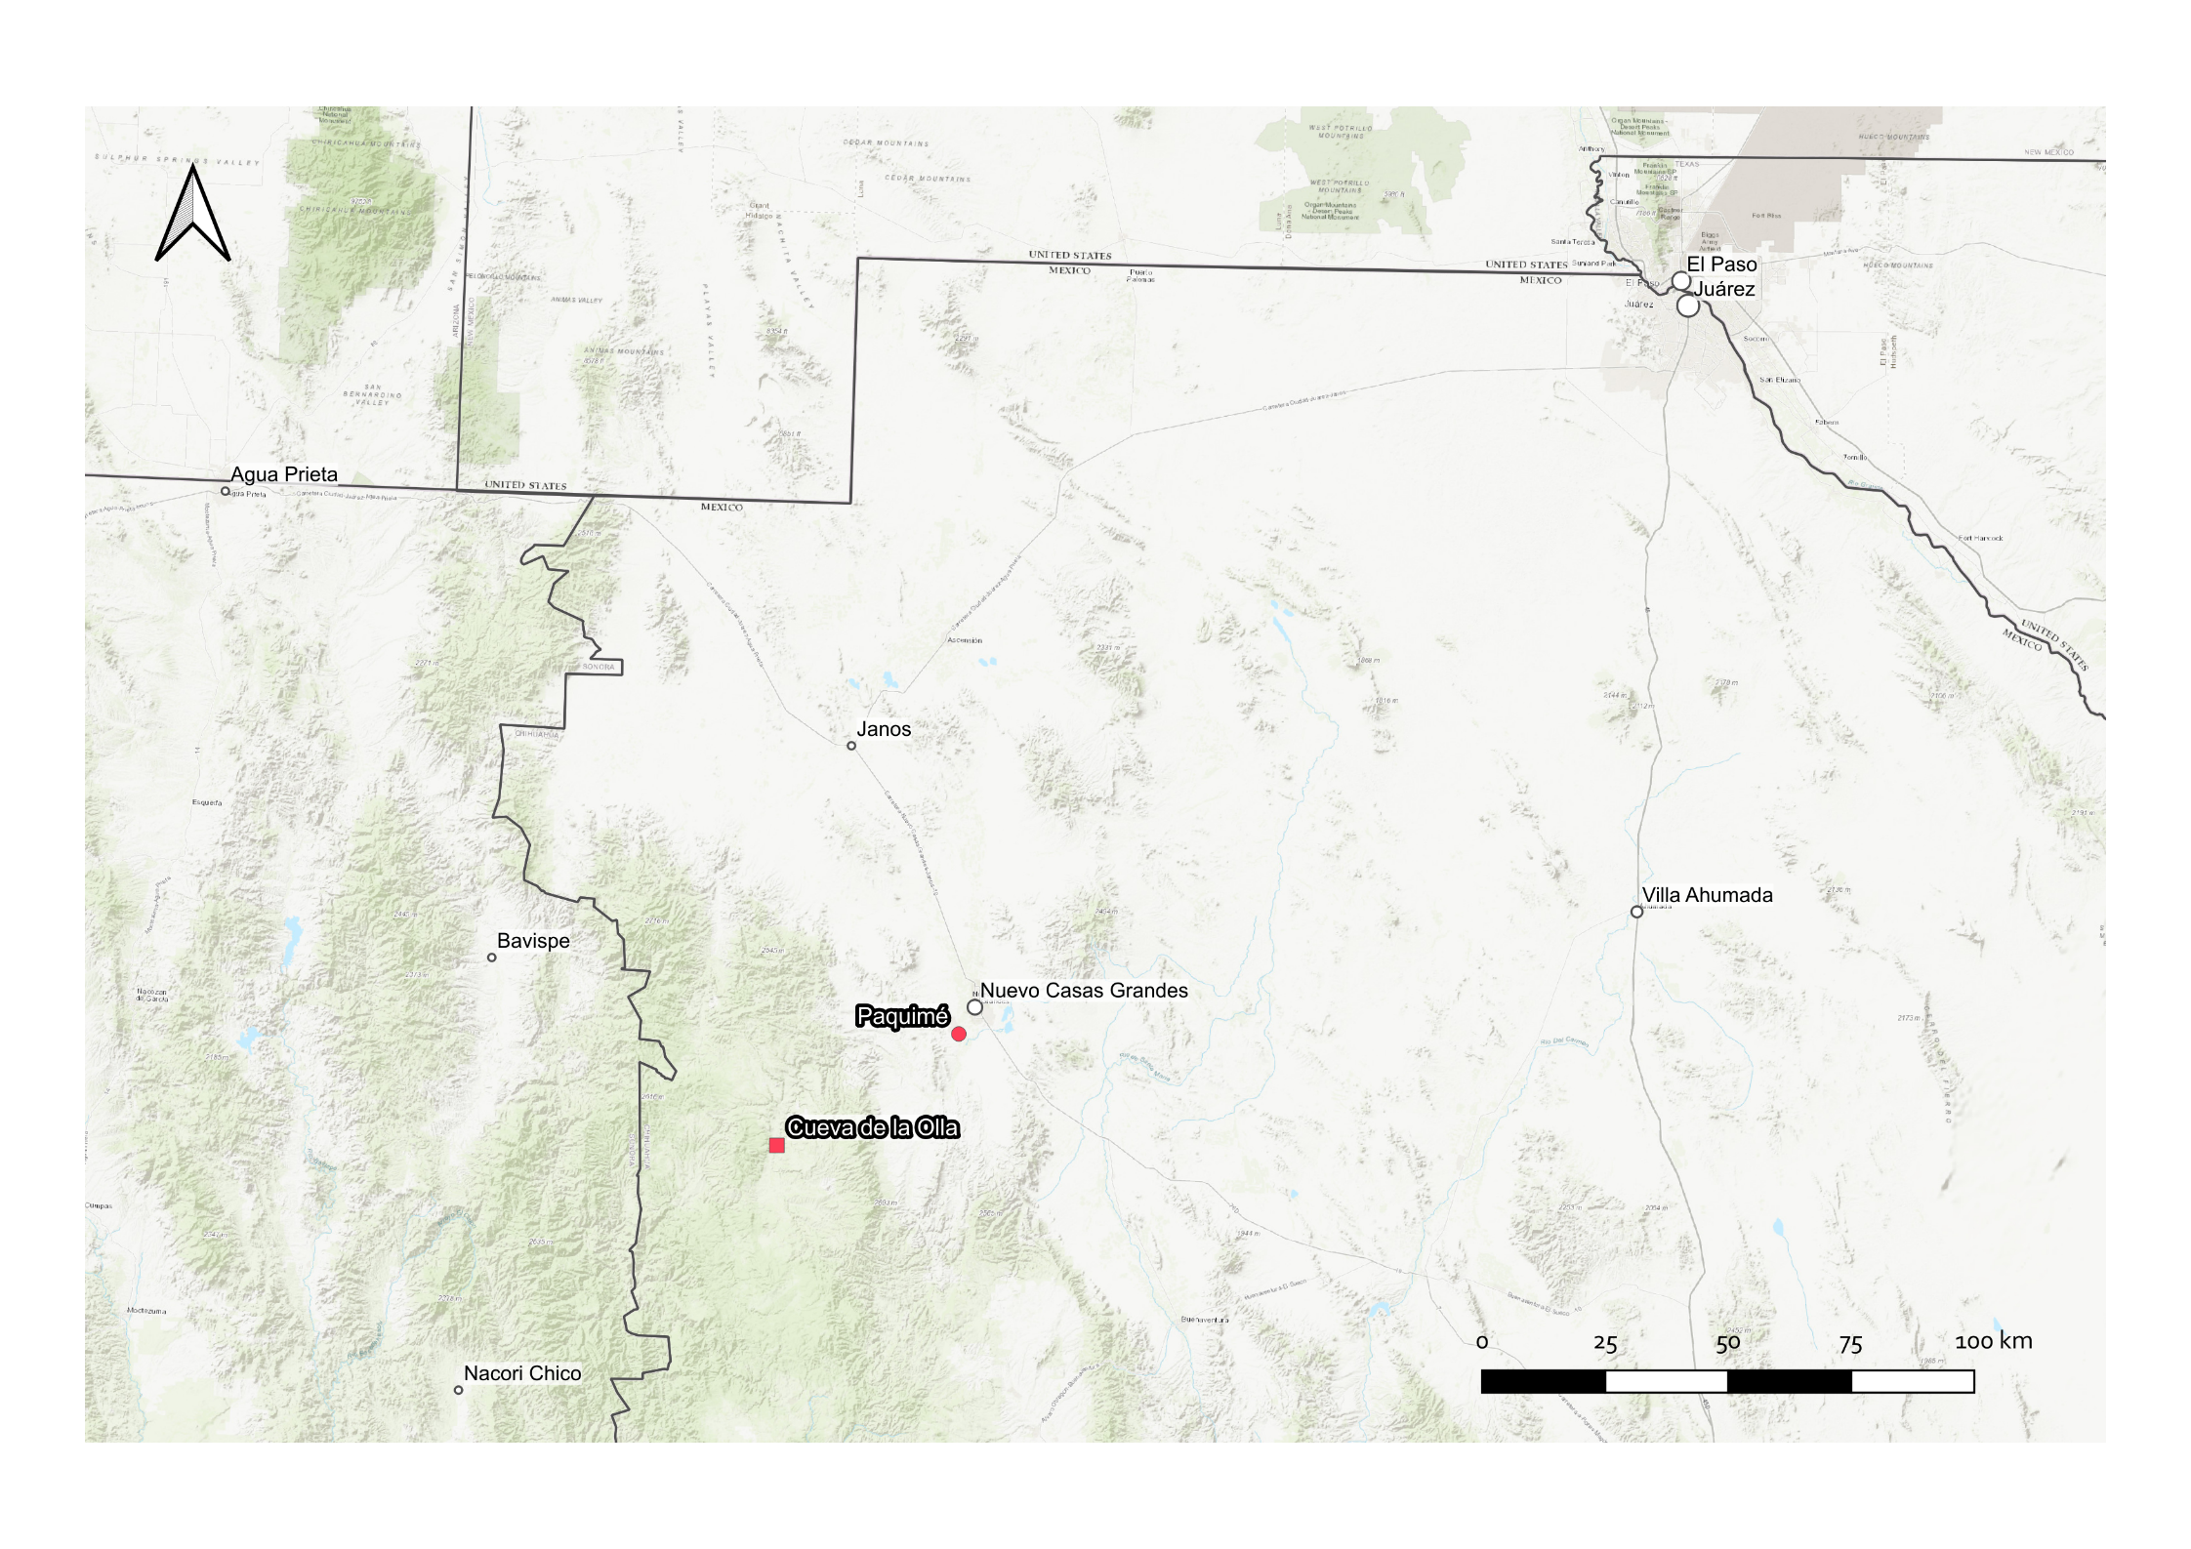

Slide 3
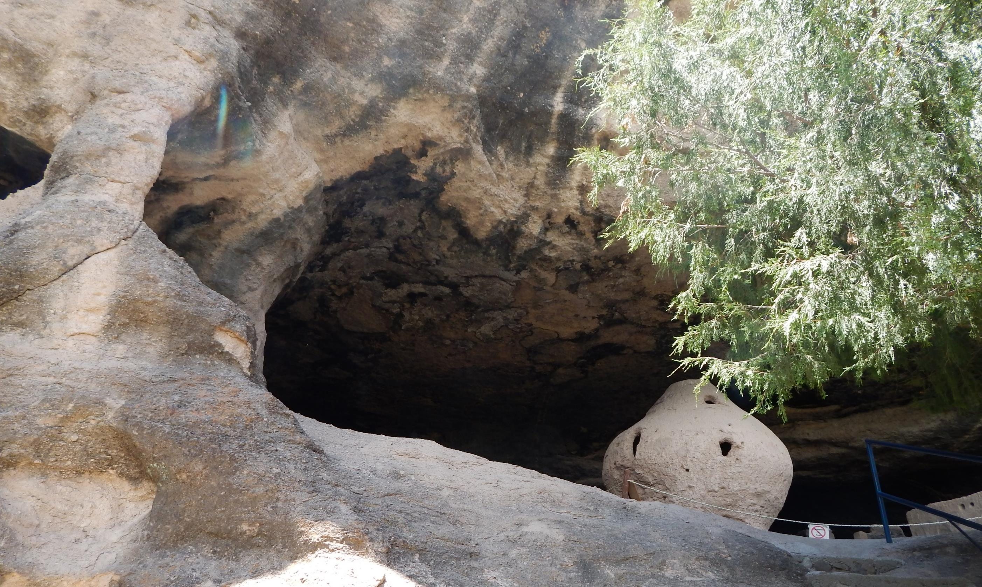
Cueva de la Olla
600-1100 d.C. (Viejo Period)
Earthen construction: 950-1060 (Perros Bravos)
Coursed Adobe (English Cob)
Wattle and Daub
Stone foundation
Casas Grandes, Chihuahua

Slide 4
Documentation history
1890-1891 | C. Lumholtz | Sketch Hand Survey
1905, 1906 | A. H. Blackiston | Description with photography
1908, 1923 | E. L. Hewett | Description with photography
1936 | E. B. Sayles | Description with photography
1943 | D. D. Brand | Description
1951-55 | R. Lister P. C. Mangelsdorf K. P. Kent | Hand Survey

Slide 5
Documentation history
1999 | E. Gamboa Carrera | Photographic recording Preliminary inventory of the region
2000 | A. Guevara Sánchez | Intervention report Photographic recording
2011 | E. Gamboa Carrera A. V. H. Medina Rubio A. G. Ríos Alvarado K. Gutiérrez Vacío | Excavation report Restoration report

Slide 6
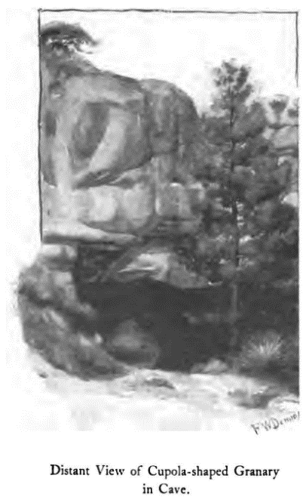
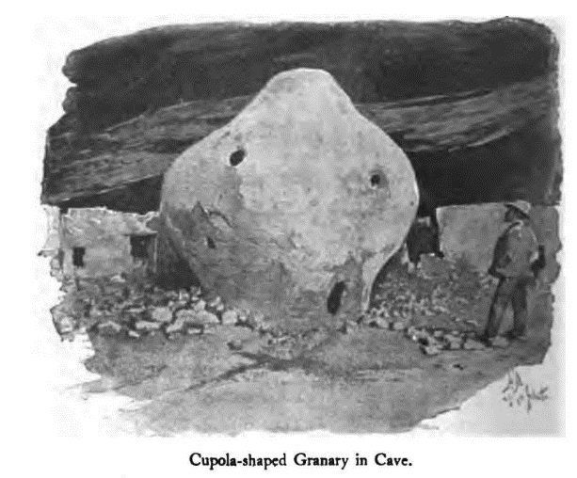
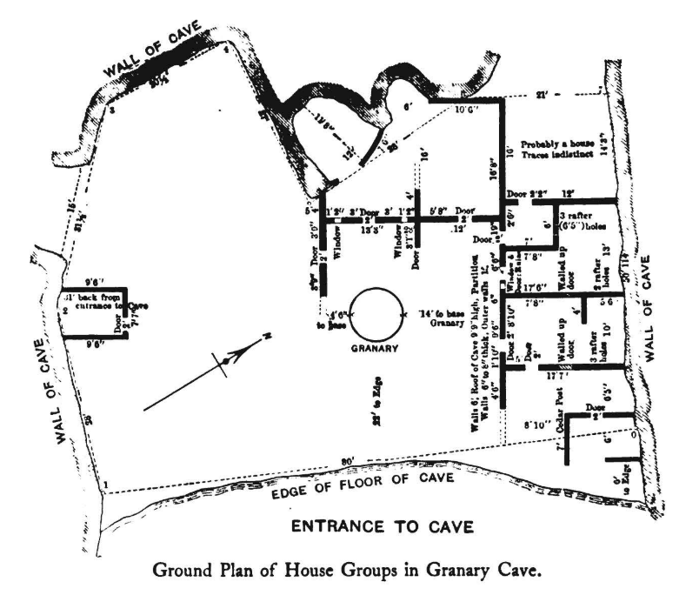
(Lumholtz, 1902, pp. 58, 62, 64)

Slide 7
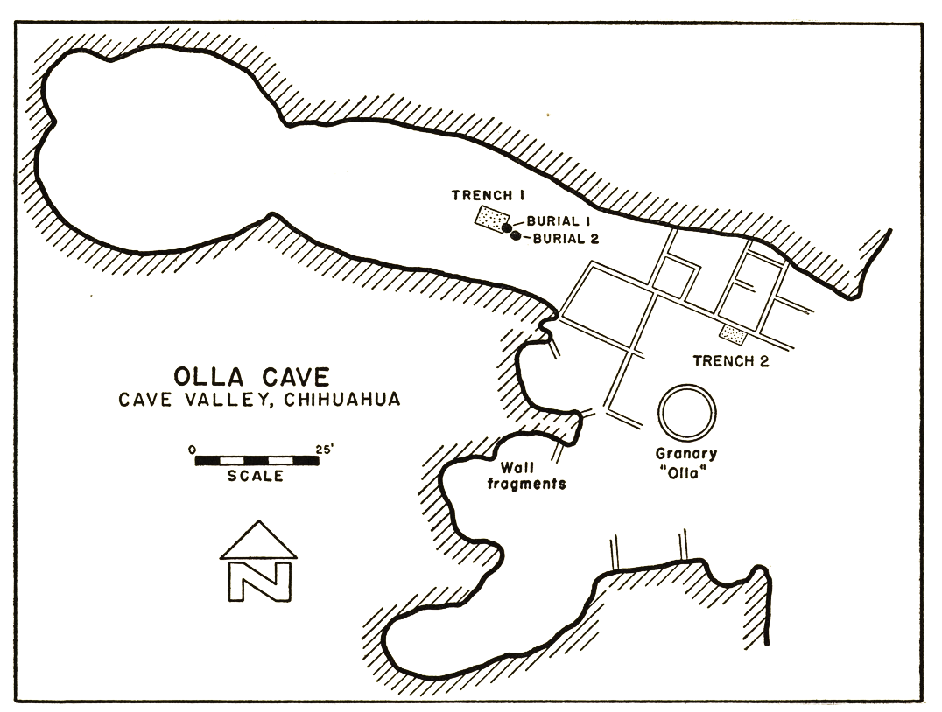
Planta de la Cueva de la Olla (Lister 1955)
(Lister, Mangelsdorf, & Peck Kent, 1958, p. 30)

Slide 8
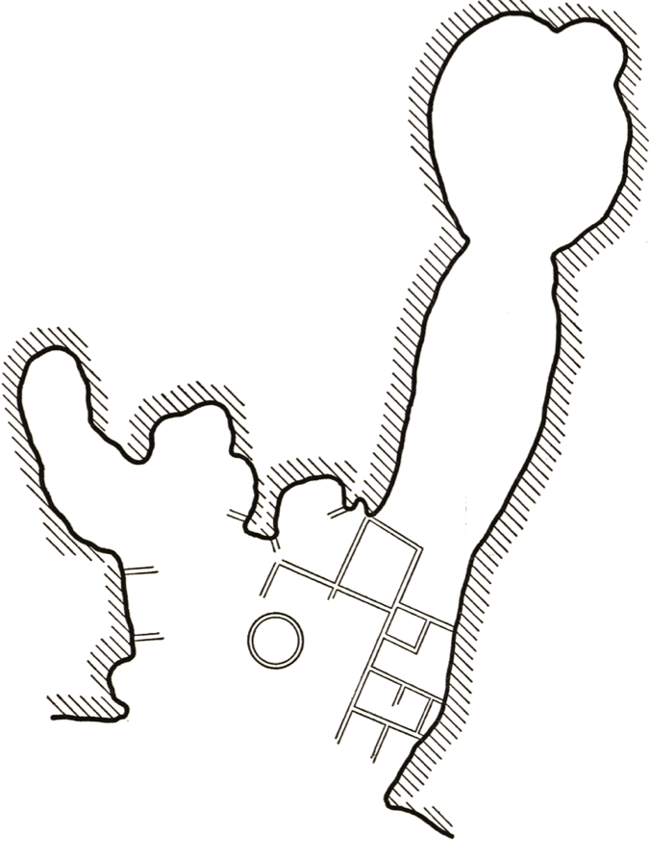






Blackiston 1905
Blackiston 1906
Hewett 1923
B06, H23
B05
Hewett 1923
H23, S36
Sayles 1936

Slide 9
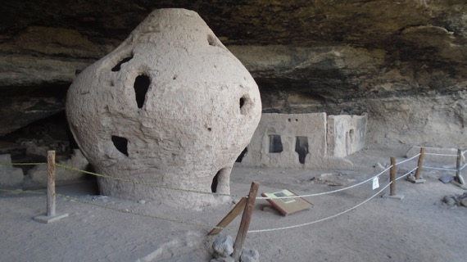
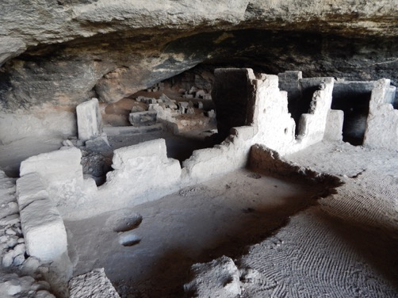
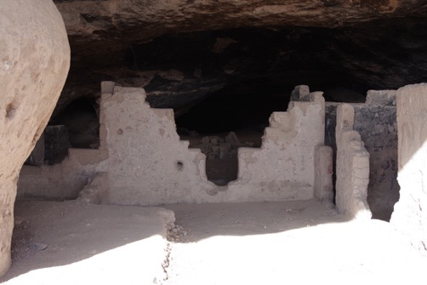
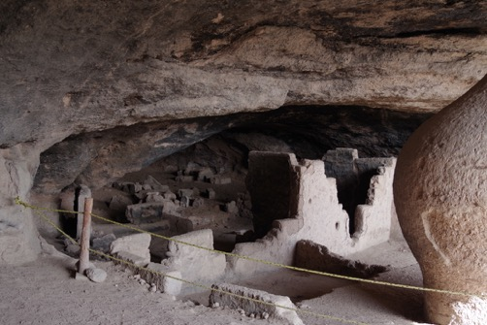
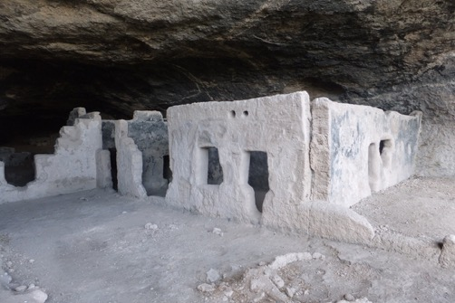
2016c
2015a
2016b
15a
16a
16c
15b
16b
2016a
2015b

Slide 10
Why do we document?
What do we document?
Which recording method do we use?
What would be the result of the documentation?

Slide 11
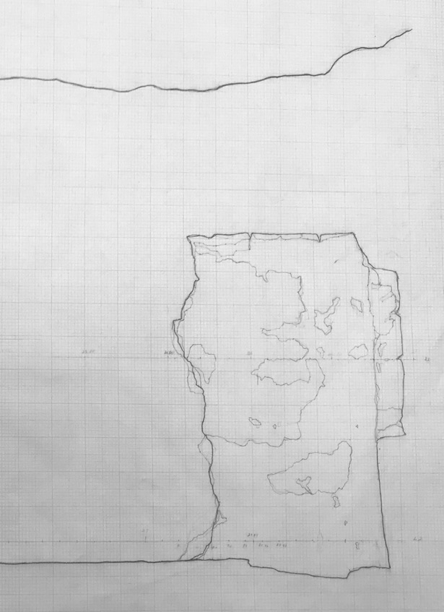
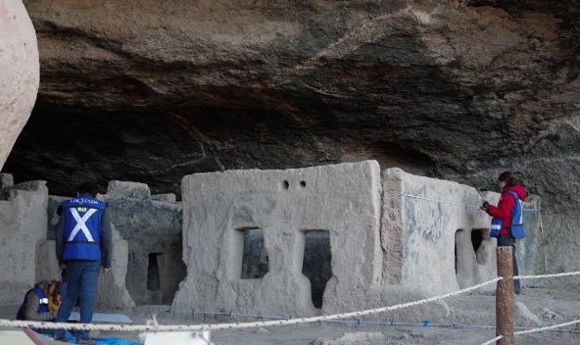
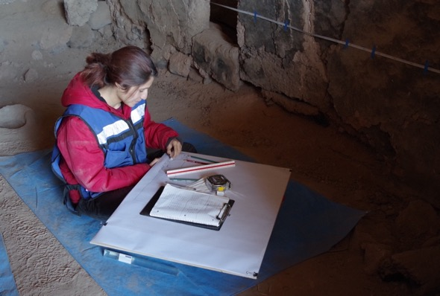
Hand Survey
    Angélica Nohemí Chávez Martínez, Luis Esteban Ramos Rivera, Luisa Fernanda Galindo Gutiérrez, Yuko Kita. 2016

Slide 12
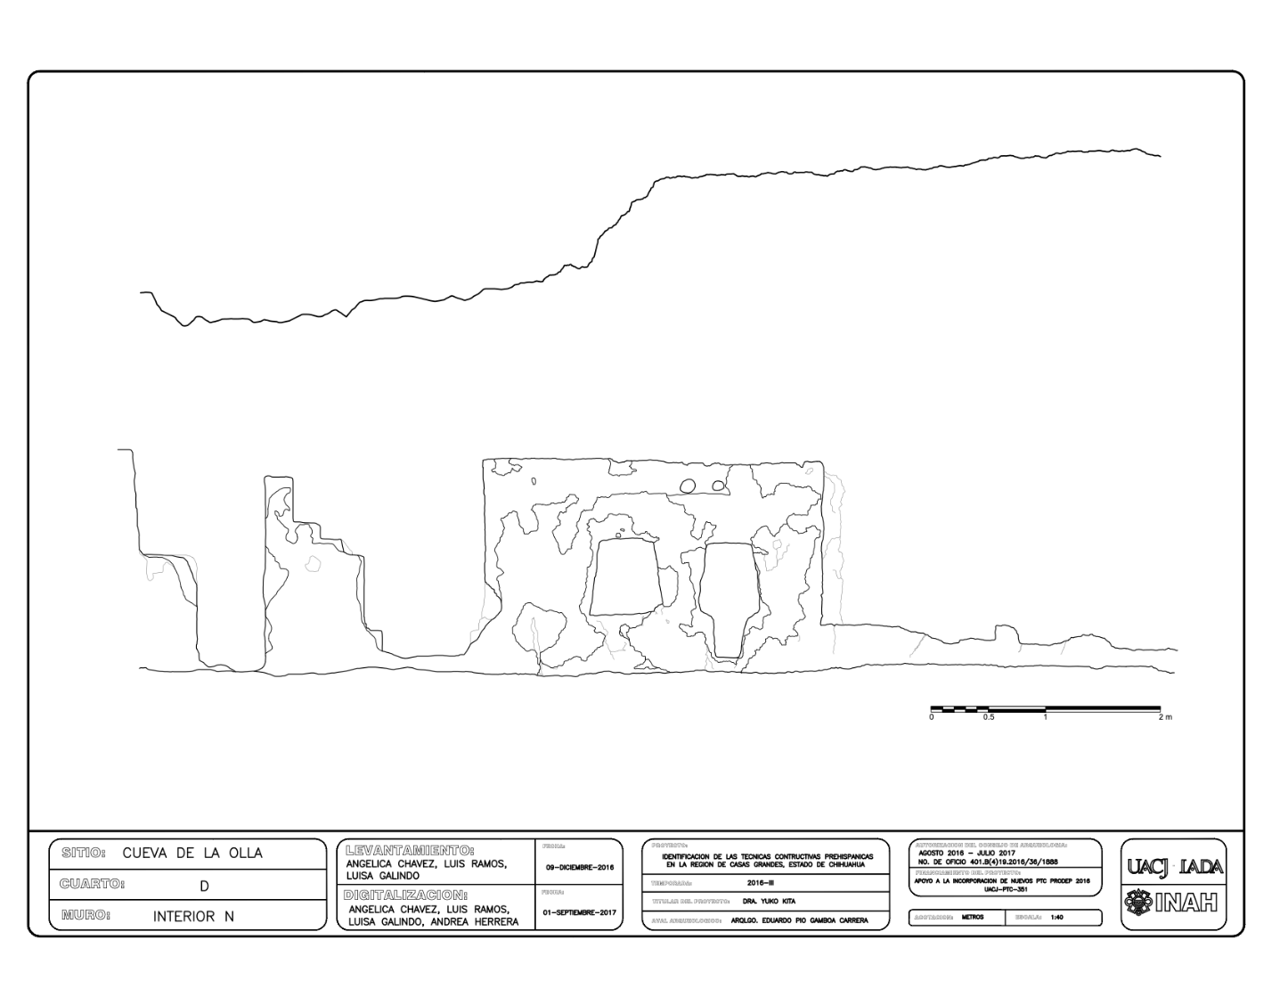
Detailed Hand Survey
Detailed elevations
As-found condition
Asset description / condition
Nordby et al. 2000 (Mesa Verde, Colorado)
Bagwell 2006 (Río Taraises, Sonora)

Slide 13
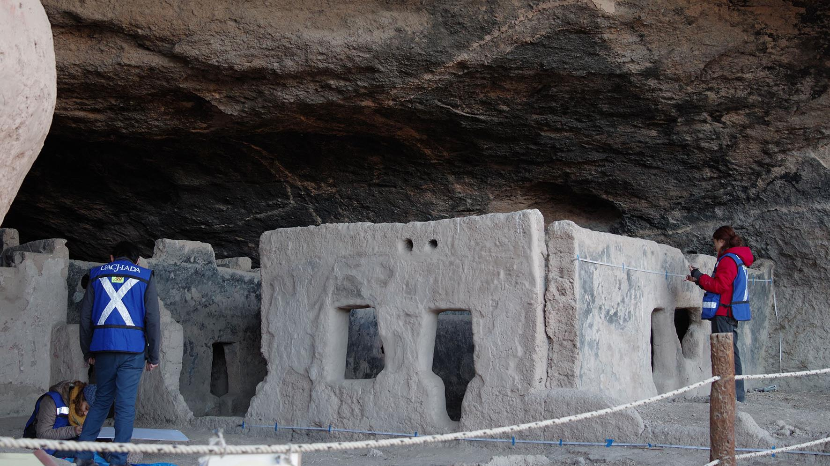

Slide 14
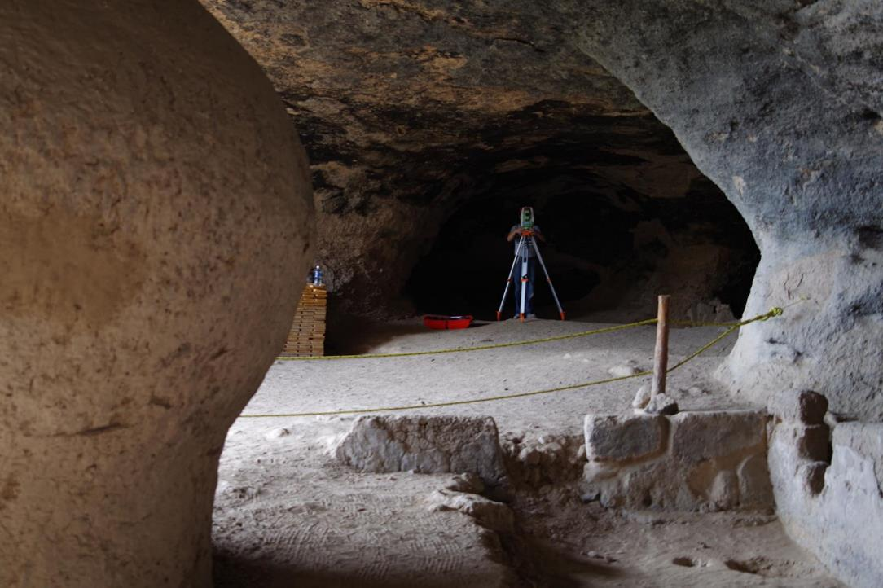
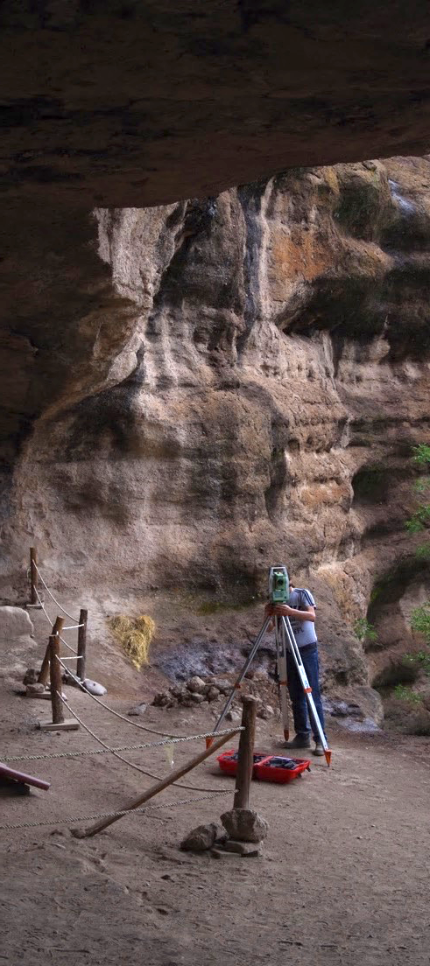
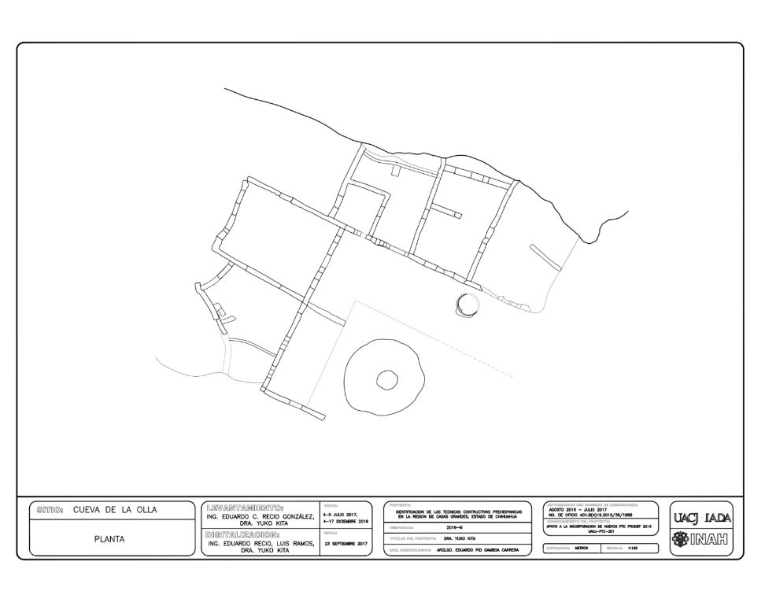
Survey with Total Station

Slide 15
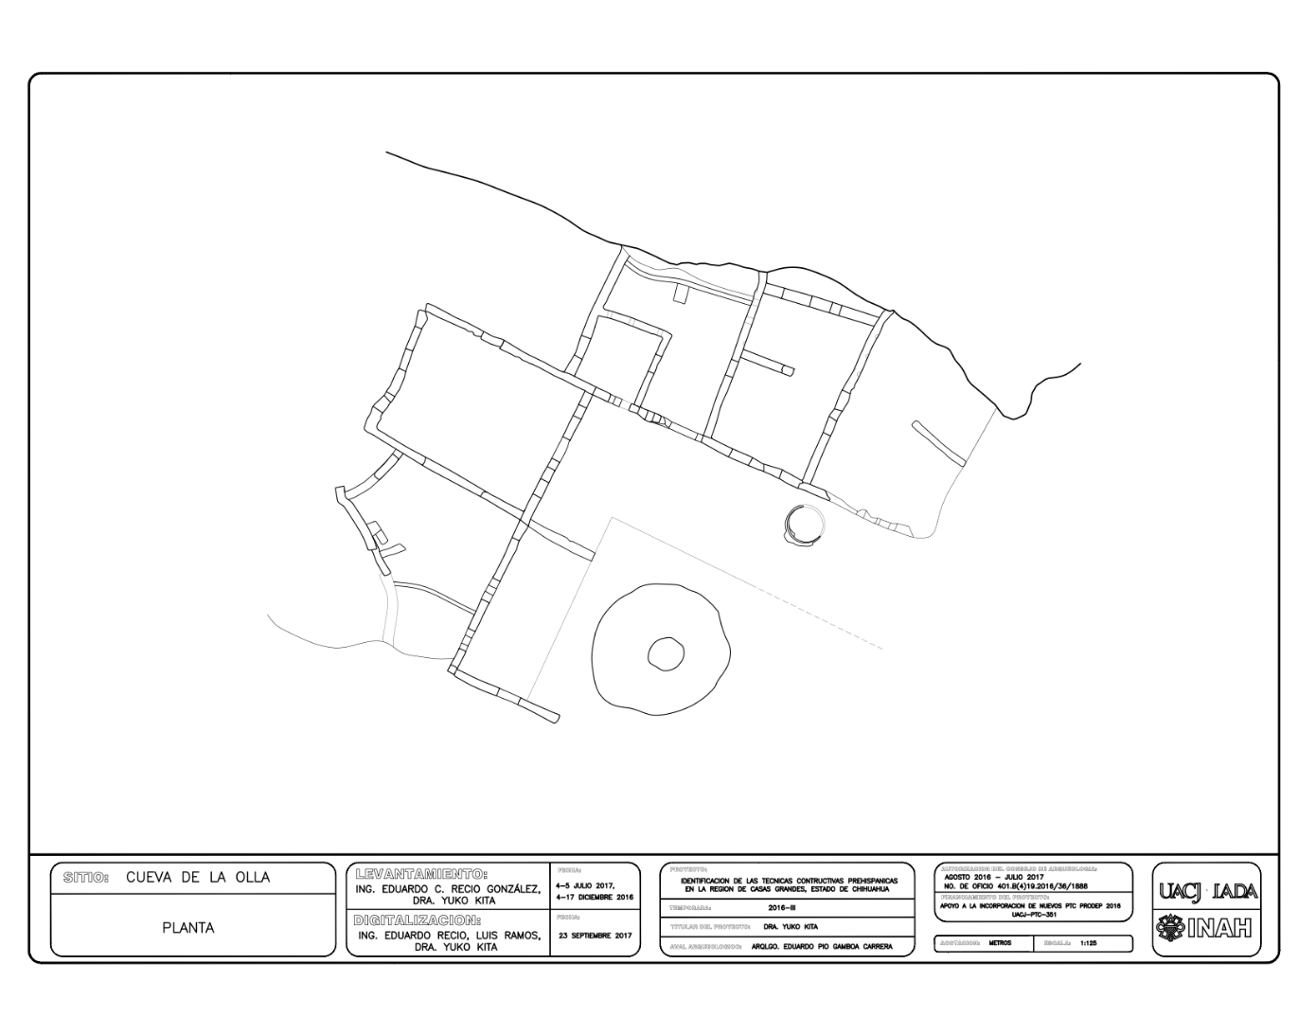
Total Station
Floor plan with wall angles and irregular form objects (Granary)
Bagwell 2006 (Río Taraises, Sonora)

Slide 16
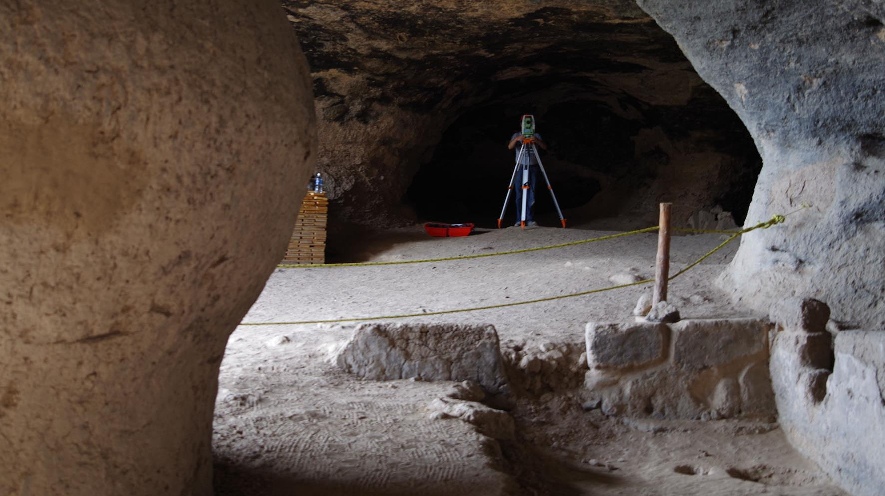

Slide 17
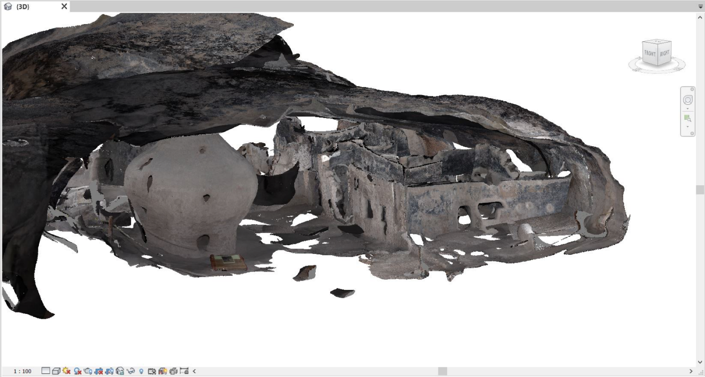
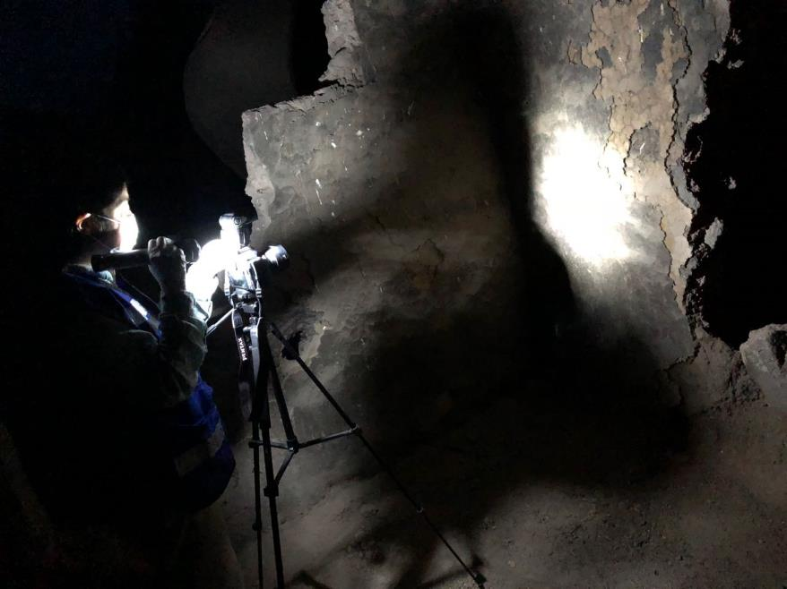
Terrestrial Photogrammetry Survey

Slide 18
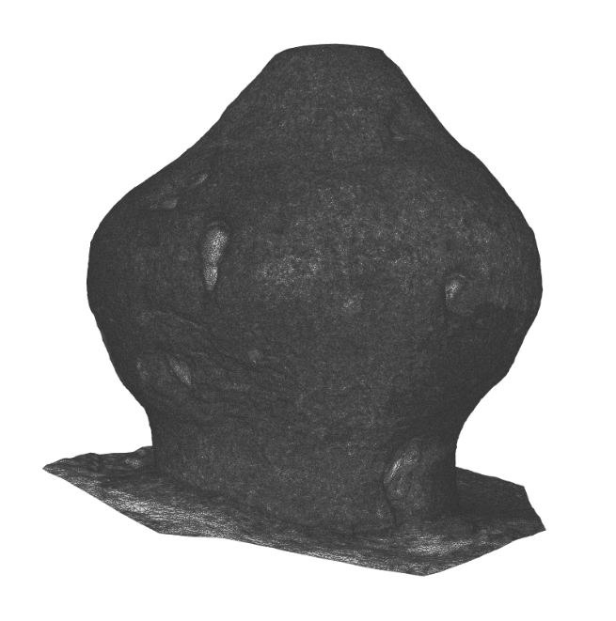
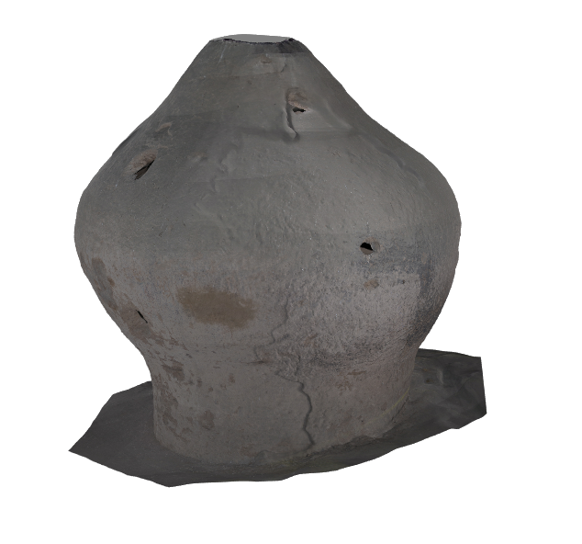
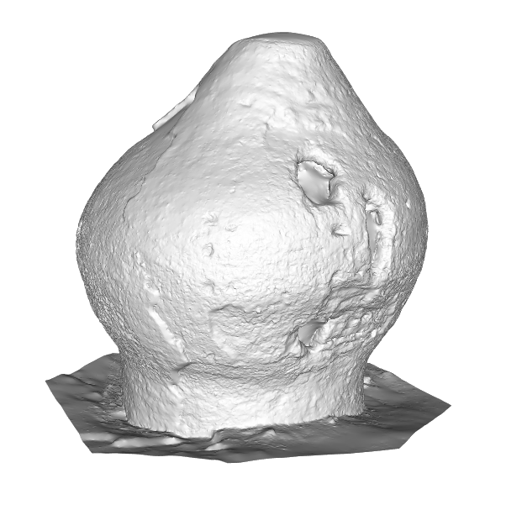
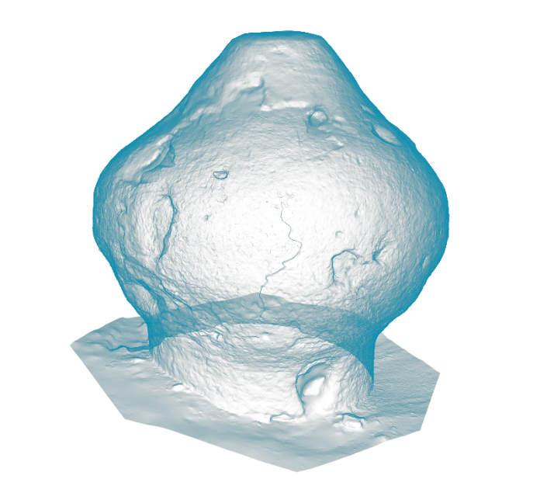
Terrestrial Photogrammetry
3D textured model
As-found condition
Asset description / condition
Spatial analysis

Slide 19
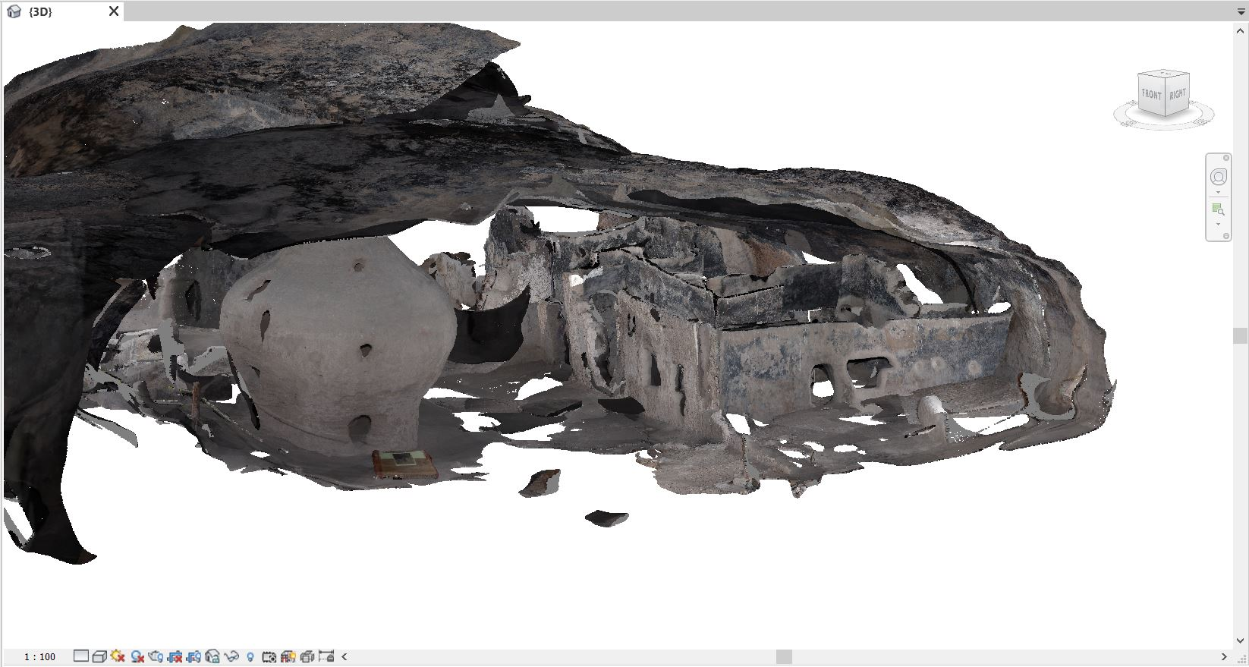
Terrestrial Photogrammetry

Slide 20
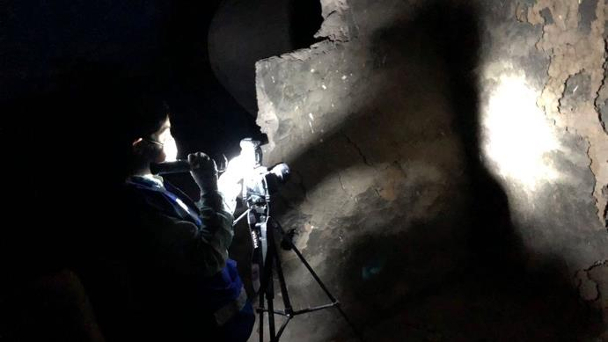

Slide 21
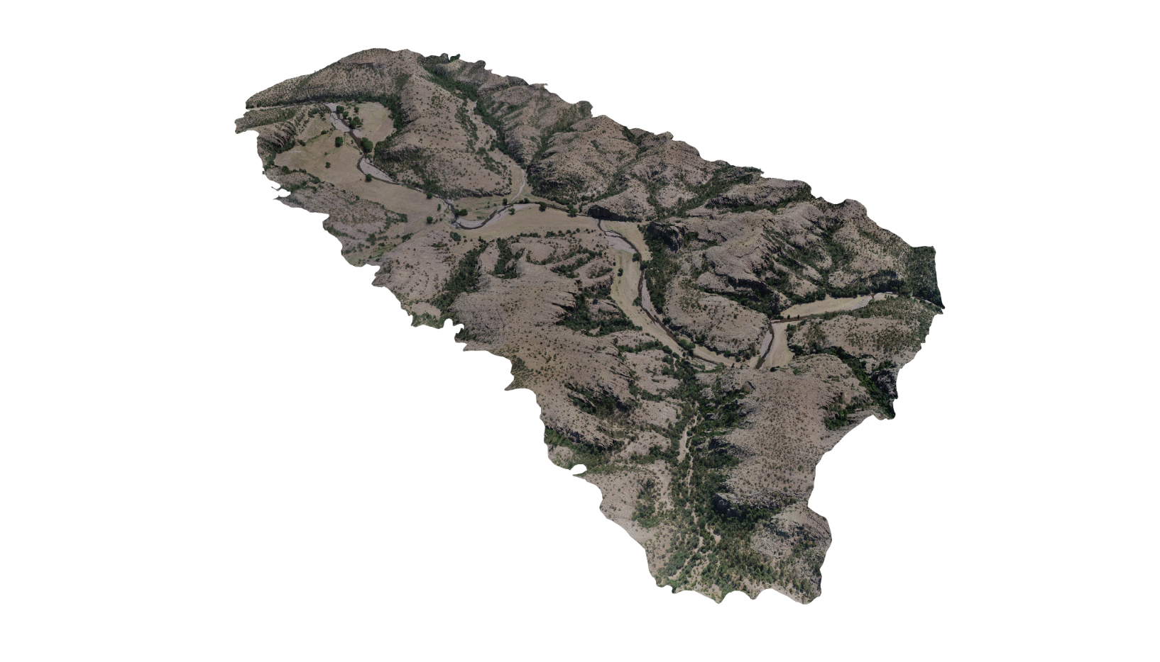
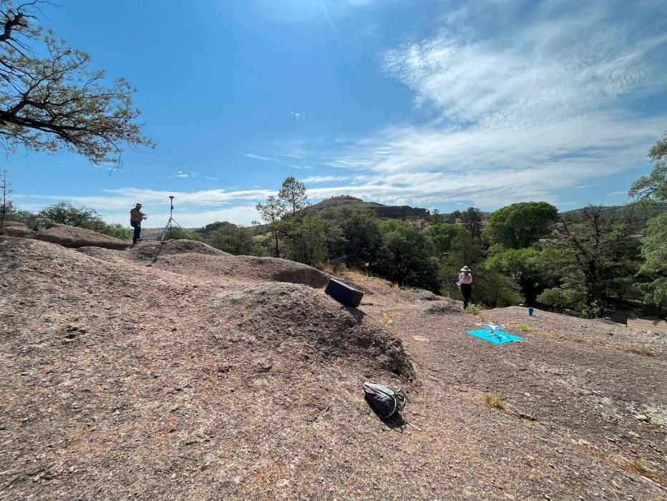
Aerial Photogrammetric Survey

Slide 22
Aerial Photogrammetric Survey
Orthophoto
Digital Terrain Model (DTM)
Topographic contour line

Slide 23
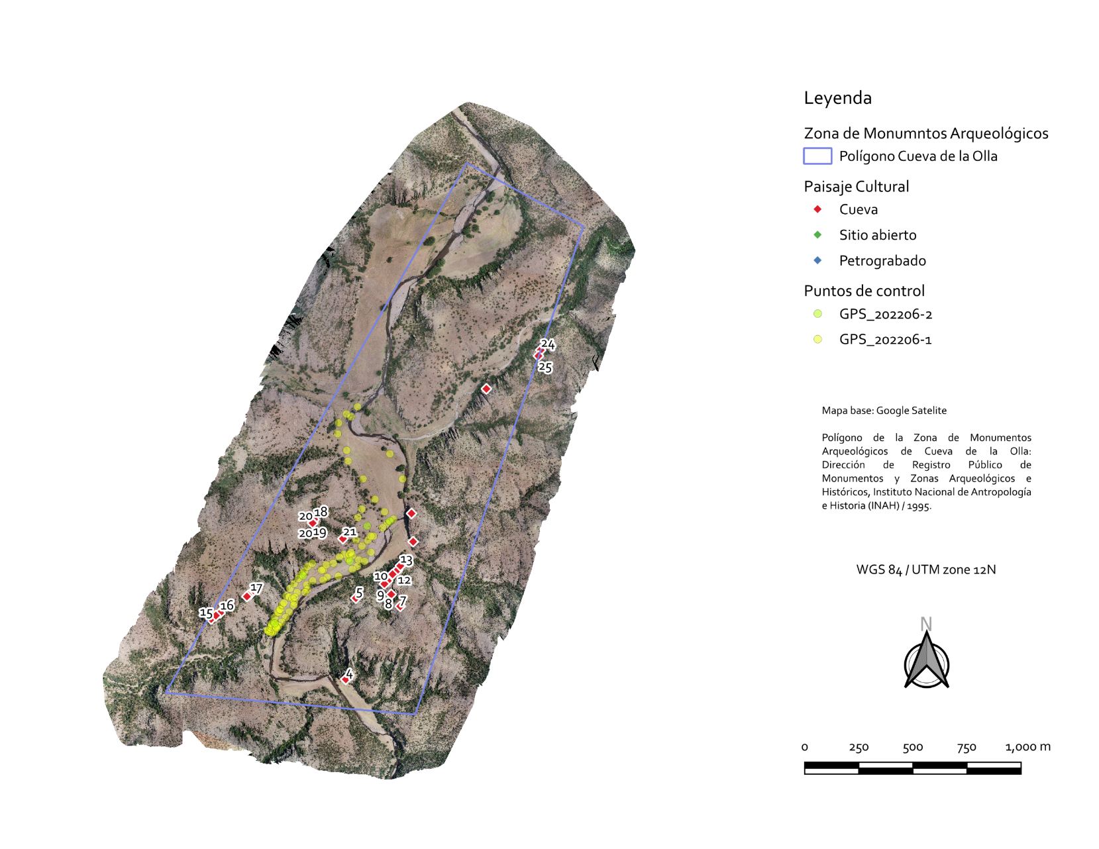
Aerial Photogrammetric Survey
Orthophoto
Digital Terrain Model (DTM)
Topographic contour line

Slide 24
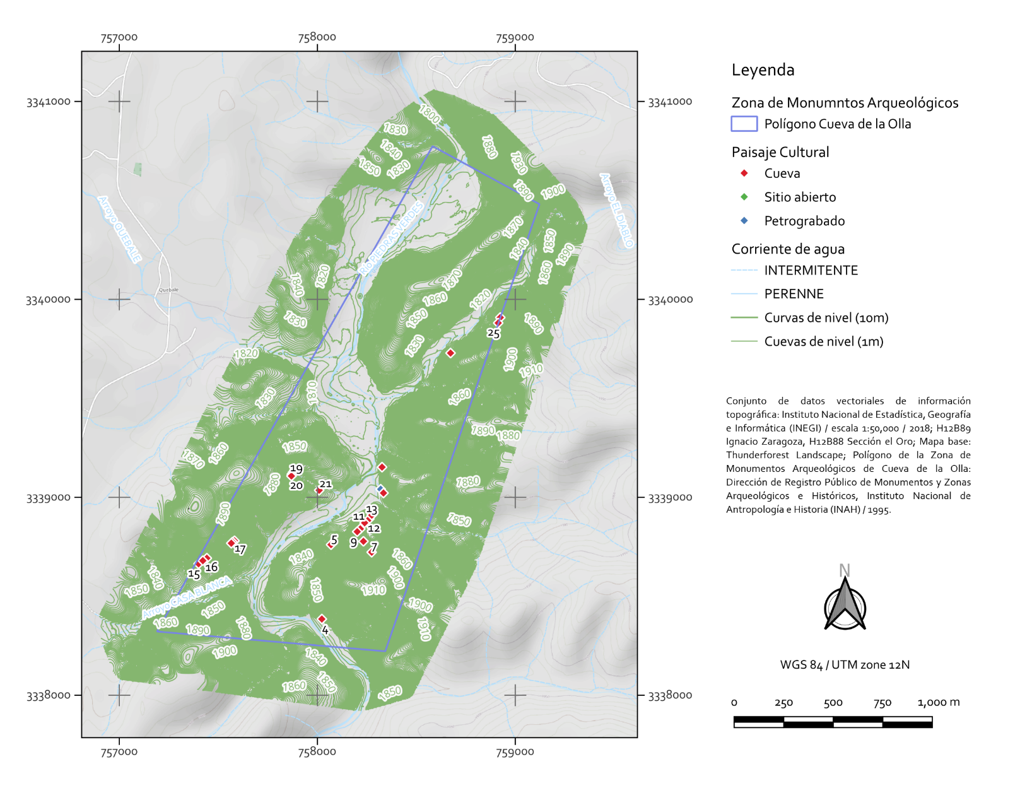
Aerial Photogrammetric Survey
Orthophoto
Digital Terrain Model (DTM)
Topographic contour line

Slide 25
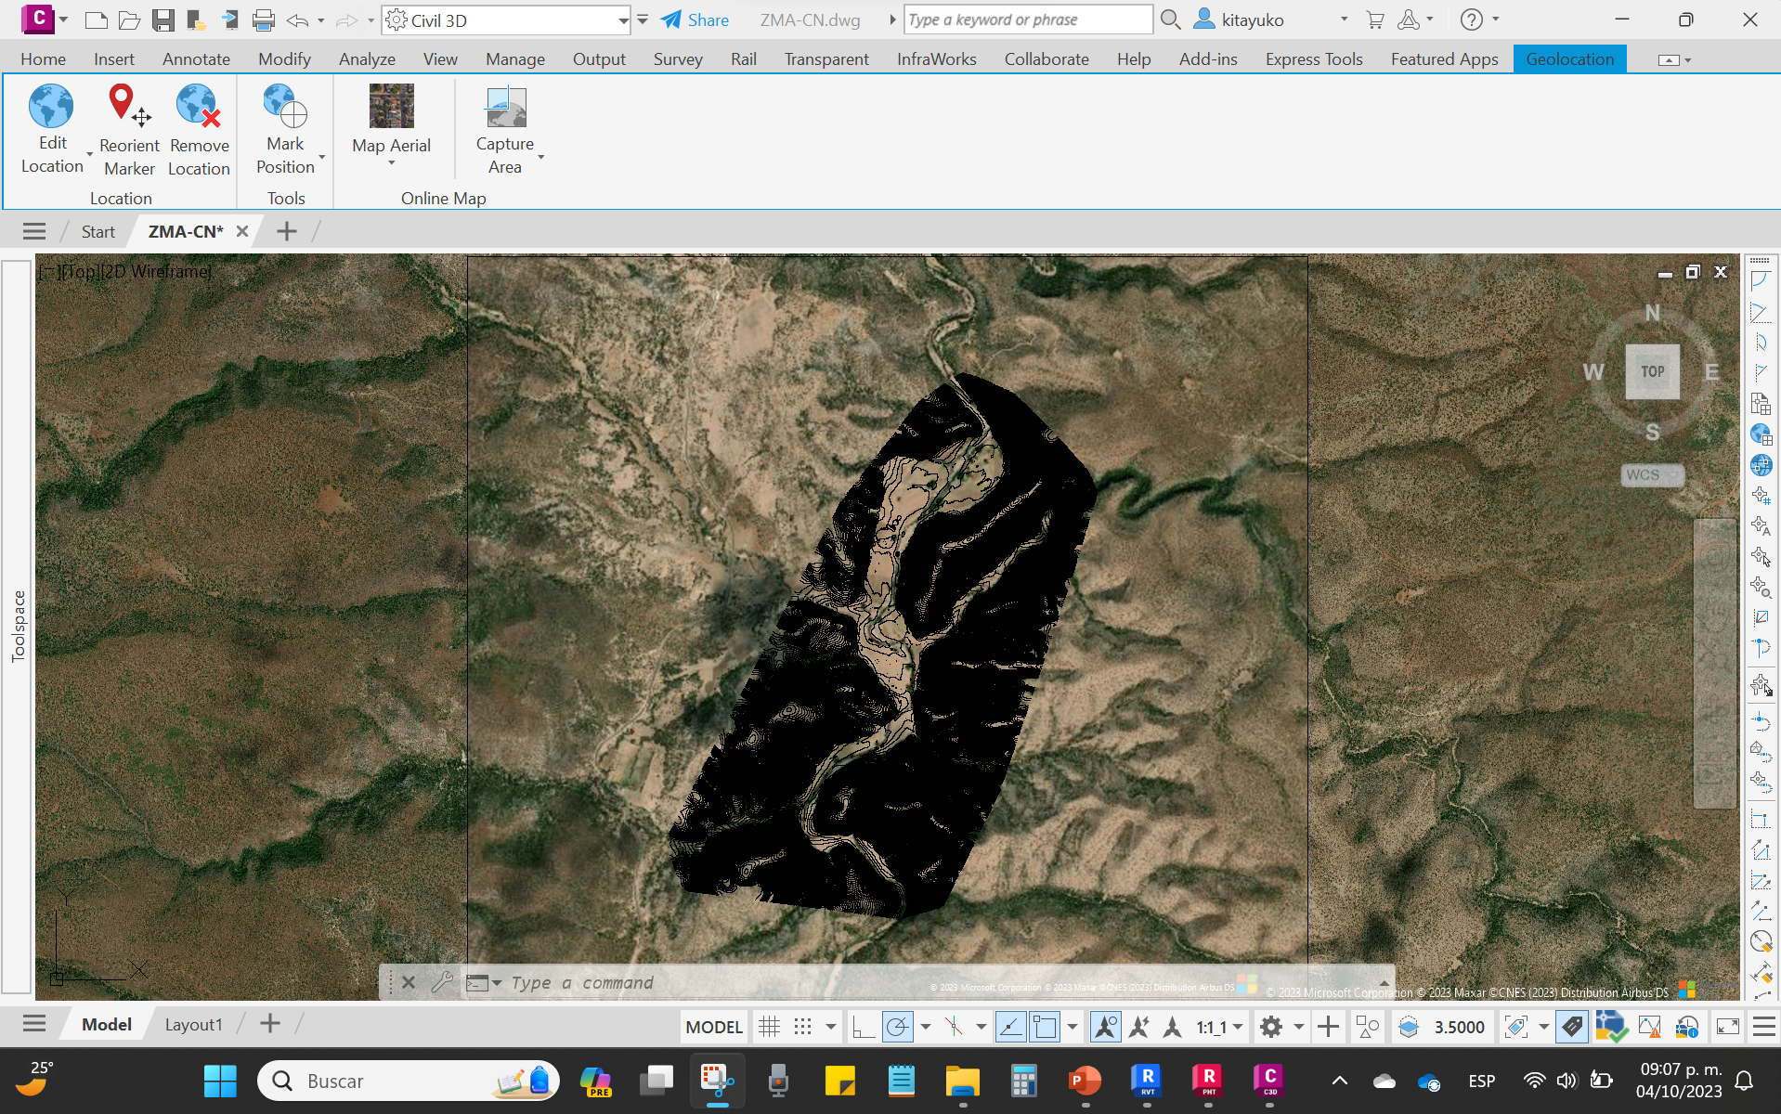
Aerial Photogrammetric Survey

Slide 26
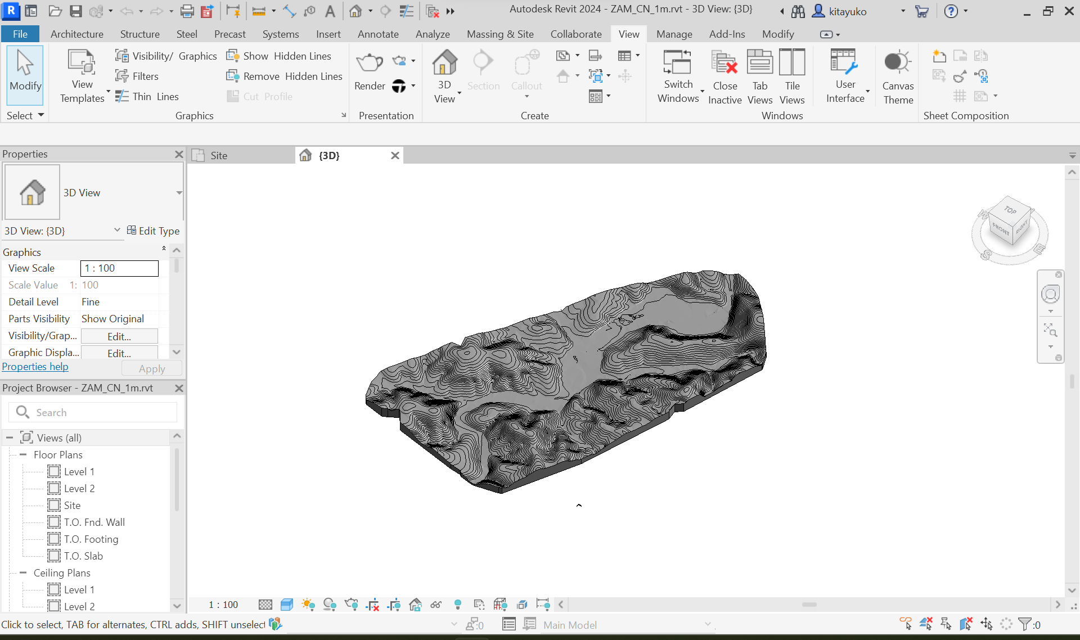
Aerial Photogrammetric Survey

Slide 27
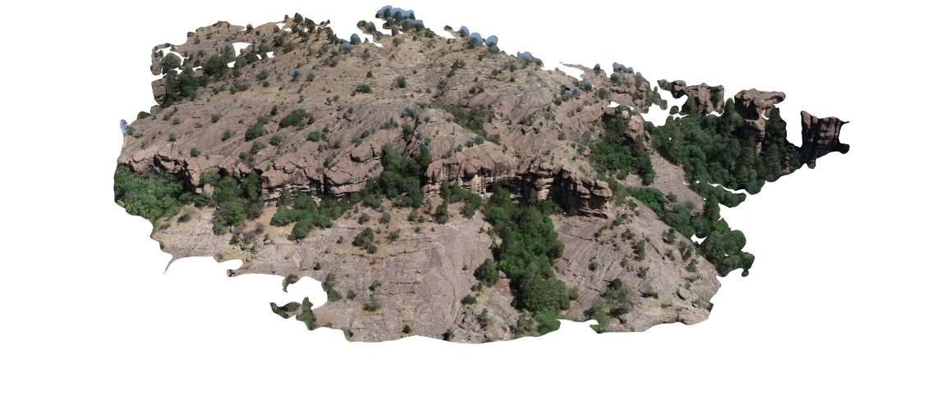
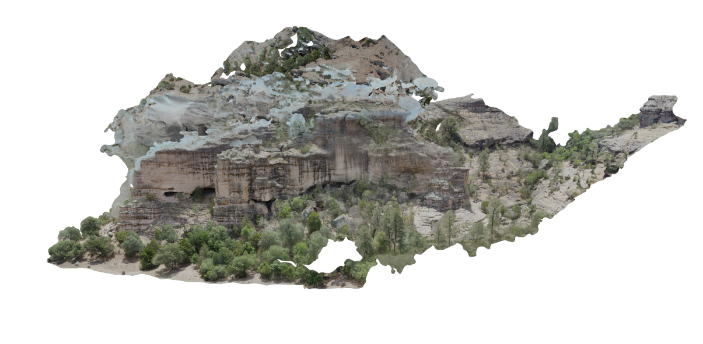
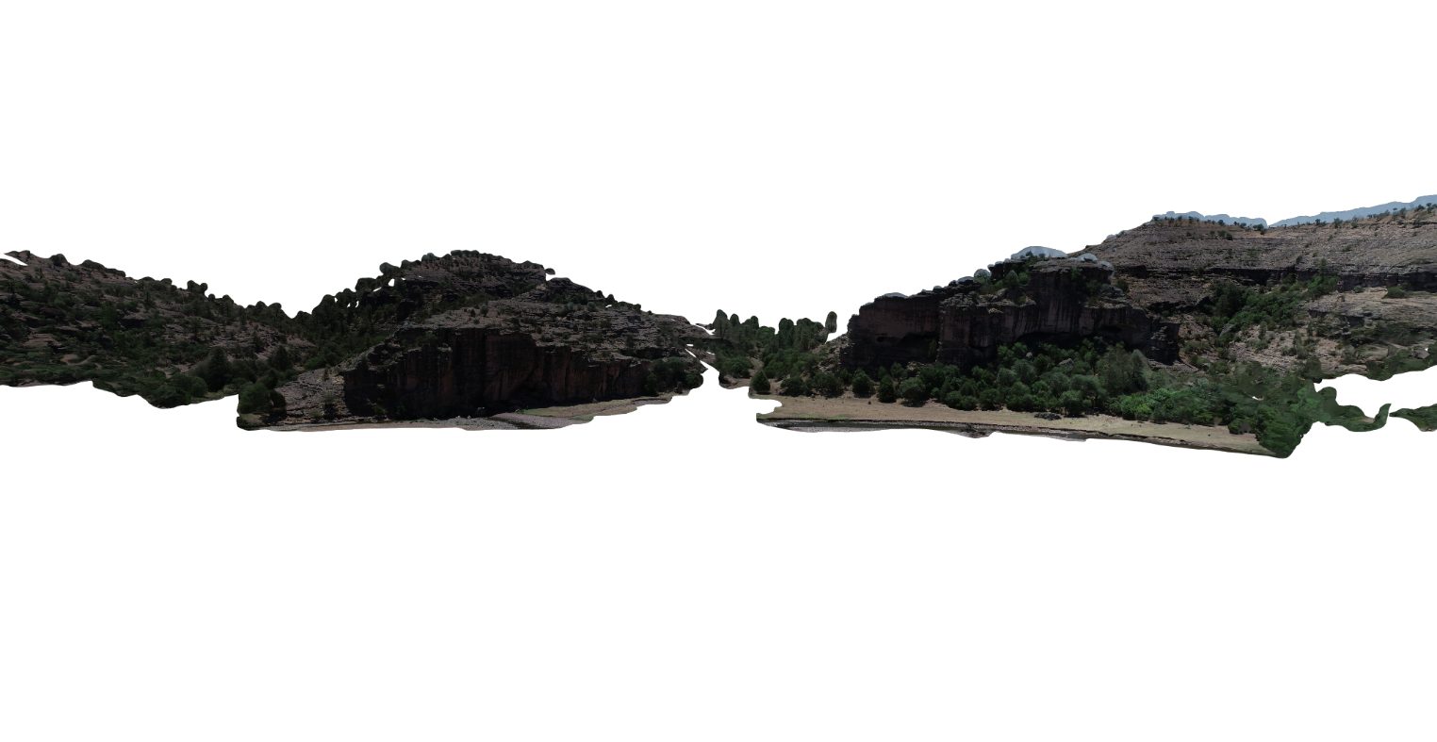
Aerial Photogrammetric Survey
3D textured model
Spatial analysis

Slide 28
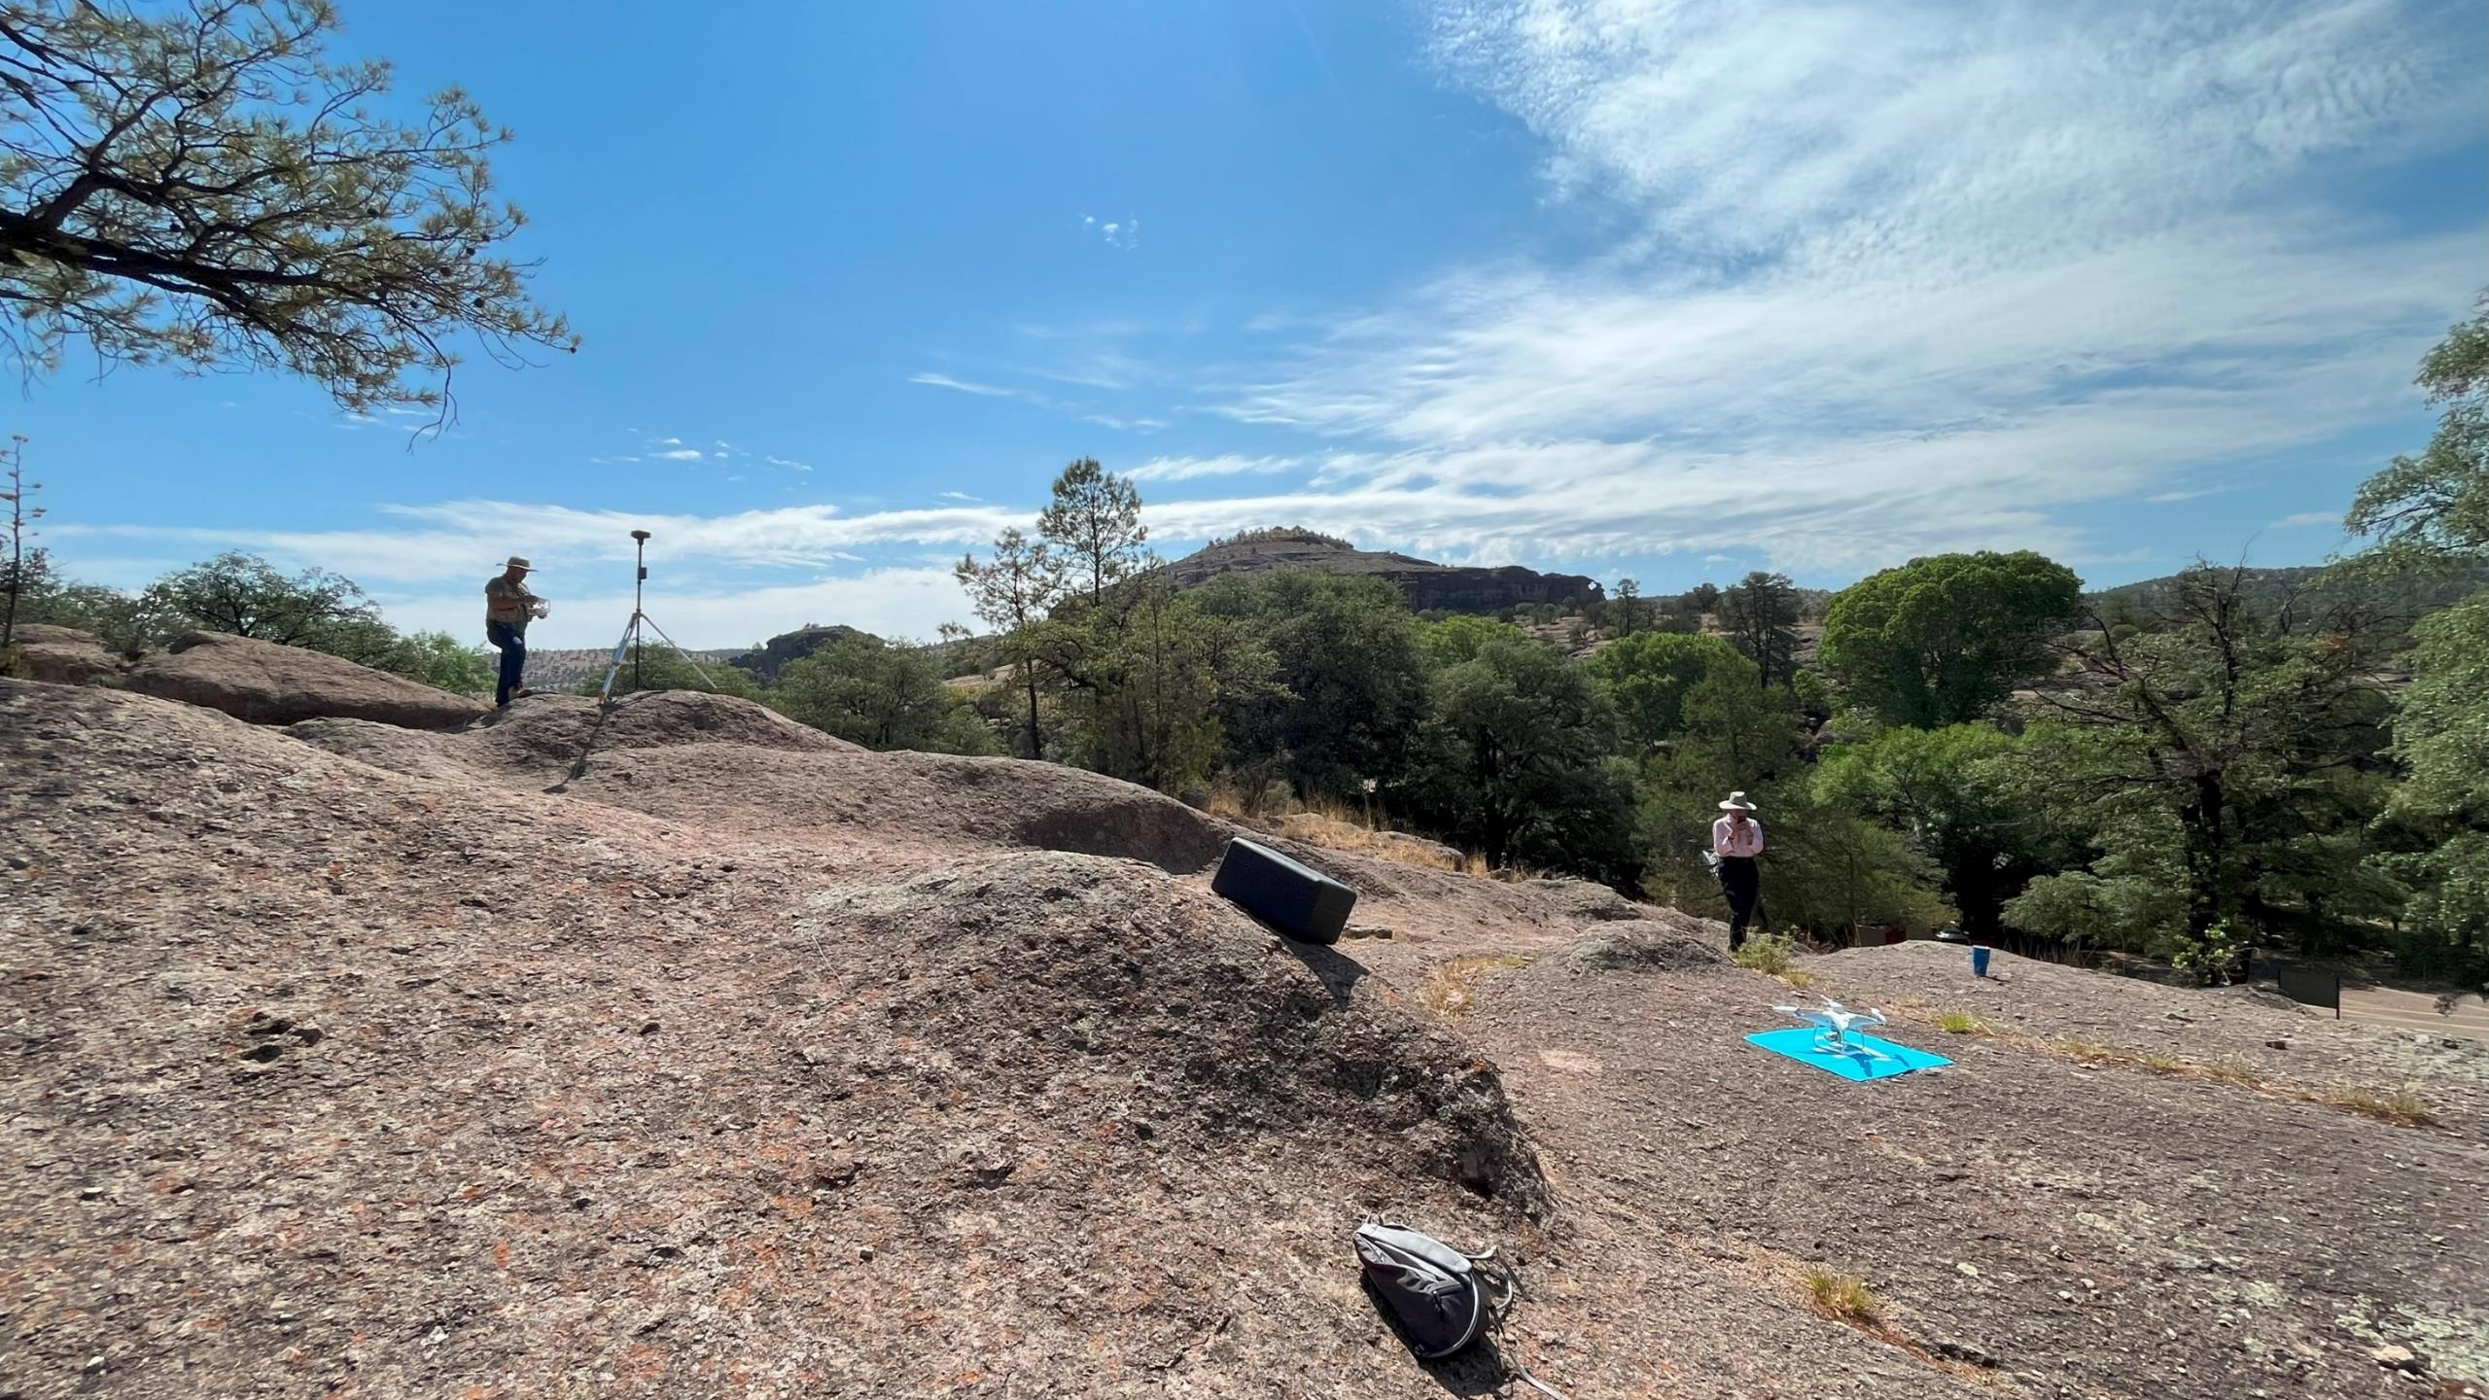

Slide 29



Collaborators
Hand survey on site:
Luisa Fernanda Galindo Gutiérrez
Luis Estéban Ramos Rivera
Angélica Nohemí Chávez Martínez
Digitalization of hand survey plans:
Andrea Herrera Arreola
Angélica Nohemí Chávez Martínez
Ariel Ivan Ortega Victoria
Francisco Javier Morales Muñoz
Liza Yazmeli Hoguin Villezcas
Luis Esteban Ramos Rivera
Luisa Fernanda Galindo Gutiérrez
Suemmi Guzmán Argueta
Wendy Leticia Lazo Huerta
Yisel Vanessa García García
Photogrammetric survey:
Mtro. Sergio Alvarado Soto
Dr. Jorge Torres Rodríguez
Angélica Nohemí Chávez Martínez
Suemi Gusmán Argueta
Ángel Alejandro Bolivar Najera
Heriberto Torres García
Adriana Edith Suárez García
TST survey:
Ing. Eduardo Carlos Recio González
Luis Estéban Ramos Rivera
Francisco Javier Morales Muñoz

Slide 30






Acknowledgements
Secretaría de Educación Pública & Instituto de Arquitectura, Diseño y Arte, UACJ
for funding (from September 2016 to present)
Consejo de Arqueología, Instituto Nacional de Antropología e Historia
for permission of projects (from July 2016 to present)
Archaeologist Eduardo Gamboa Carrera, Centro INAH Chihuahua
for supervision of projects (from July 2016 to present)

Slide 31
Acknowledgements
Ramiro Nevares & Ramiro López, Centro INAH Chihuahua
  for supervision of projects on Cueva de la Olla site
  Dr. Jorge Carrera Robles, Centro INAH Chihuahua
  for supporting field work
  Instituto de Ingeniería y Tecnología, UACJ
  for supporting with equipment and infrastructure

Slide 32
Bibliography
Alessandri, L., V. Baiocchi, S. Del Pizzo, F. Di Ciaccio, M. Onori, M. F. Rolfo, y S Troisi. 2019. “Three-dimensional survey of Guattari Cave with traditional and mobile phone cameras”. The International Archives of the Photogrammetry, Remote Sensing and Spatial Information Sciences XLII-2/W11: 37–41. https://doi.org/10.5194/isprs-archives-XLII-2-W11-37-2019.
Bagwell, Elizabeth A. 2006. “Domestic architectural production in northwest Mexico”. The University of New Mexico. https://search.proquest.com/docview/305275922?accountid=151132.
Blackiston, A. Hooton. 1905. “Cliff Dwellings in Northern Mexico”. Records of the Past 4 (12): 355–361.
Blackiston, A. Hooton. 1906. “Cliff Ruins of Cave Valley, Northern Mexico”. Records of the Past 5 (1): 5–11.
Brand, Donald Dilworth. 1943. “The Chihuahua Culture Area”. New Mexico Anthropologist 6–7 (3): 115–158.
Eppich, Rand, y Amel Chabbi. 2007. Recording, Documentation, and Information Management for the Conservation of Heritage Places: Illustrated Examples. Los Angeles: The Getty Conservation Institute.
Gamboa Carrera, Eduardo. 1999. “Arqueología de la provincia serrana de Paquimé. Sección Río Piedras Verdes, Chihuahua.” Ciudad de México.
Gamboa Carrera, Eduardo, Ángel Víctor Hugo Medina Rubio, Amanda Guadalupe Ríos Alvarado, y Karina Gutiérrez Vacío. 2011. “Informe del Proyecto de investigación, conservación y difusión del patrimonio arqueológico Temporada 2011 de la zona de monumentos arqueológicos Cueva de la Olla”. Ciudad de México.
Guevara Sánchez, Arturo. 2000. “Informe del mantenimiento menor dado a estructuras de Las Cuarenta Casas y de la Cueva de la Olla, Chihuahua.” Ciudad de México.
Hewett, Edgar Lee. 1908. “Les Communautés Anciennes Dans Le Desert Américain: Recherches Archéologiques sur la distribution et l’organisation sociale des anciennes populations au Sud Ouest des Etats Unis et au Nord du Mexique”. Geneva: Librairie Kundig.
Hewett, Edgar Lee. 1923. “Anahuac and Aztlan: retracing the legendary footsteps of the Aztecs”. Art and Archaeology 16 (1–2): 35–50. https://archive.org/details/artarchaeology16arch.
Letellier, Robin, Werner Schmid, y François LeBlanc. 2007. Recording, Documentation, and Information Management for the Conservation of Heritage Places: Guiding Principles. Los Angeles: The Getty Conservation Institute.
Lister, Robert H., Paul C. Mangelsdorf, y Kate Peck Kent. 1958. Archaeological Excavations in the Northern Sierra Madre Occidental, Chihuahua and Sonora, Mexico. Editado por Karl K. Hulley. Boulder. Boulder: University of Colorado. http://scholar.colorado.edu/santhro/10.
Lumholtz, Carl. 1902. Unknown Mexico, Vol. I. New York: ﻿Charles Scribner's Sons.
Nordby, Larry V., Todd R. Metzger, Cynthia L. Williams y James D. Mayberry. 2000. “Mesa Verde National Park Site Conservation Program Guidelines. Volume 1: Standards for Field Data Collection and Documentation”. Mesa Verde National Park, Colorado: Mesa Verde National Park Division of Research and Resources Management.
Sayles, E. B. 1936. An Archaeological Survey of Chihuahua, Mexico. Medallion Papers No. XXII. Arizona: Gila Pueblo Foundation, Globe.

Slide 33
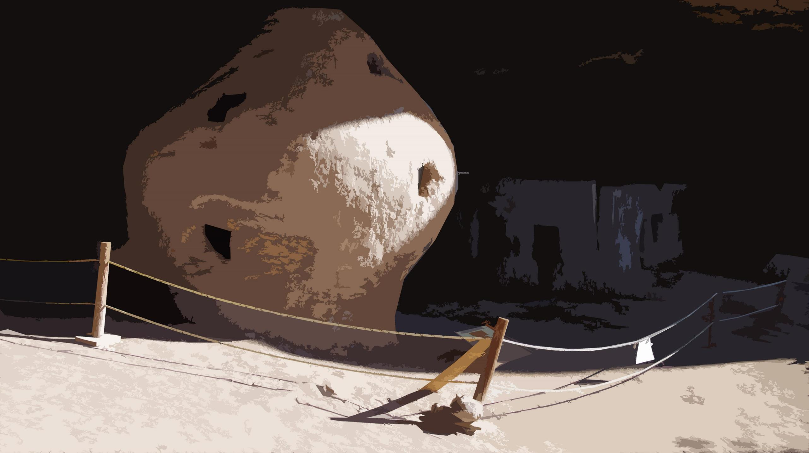
Thank you!

