Slide 1
Global North
Global South
Oscar Javier Montiel Mendez
Universidad Autonoma de Ciudad Juarez
MANAGEMENT & BUSINESS: A GEOPOLITICAL & PRODUCTIVITY PERSPECTIVE
8° Congreso Internacional Ingenio y Emprendimiento
Unicafam
06/11/2025

Slide 2
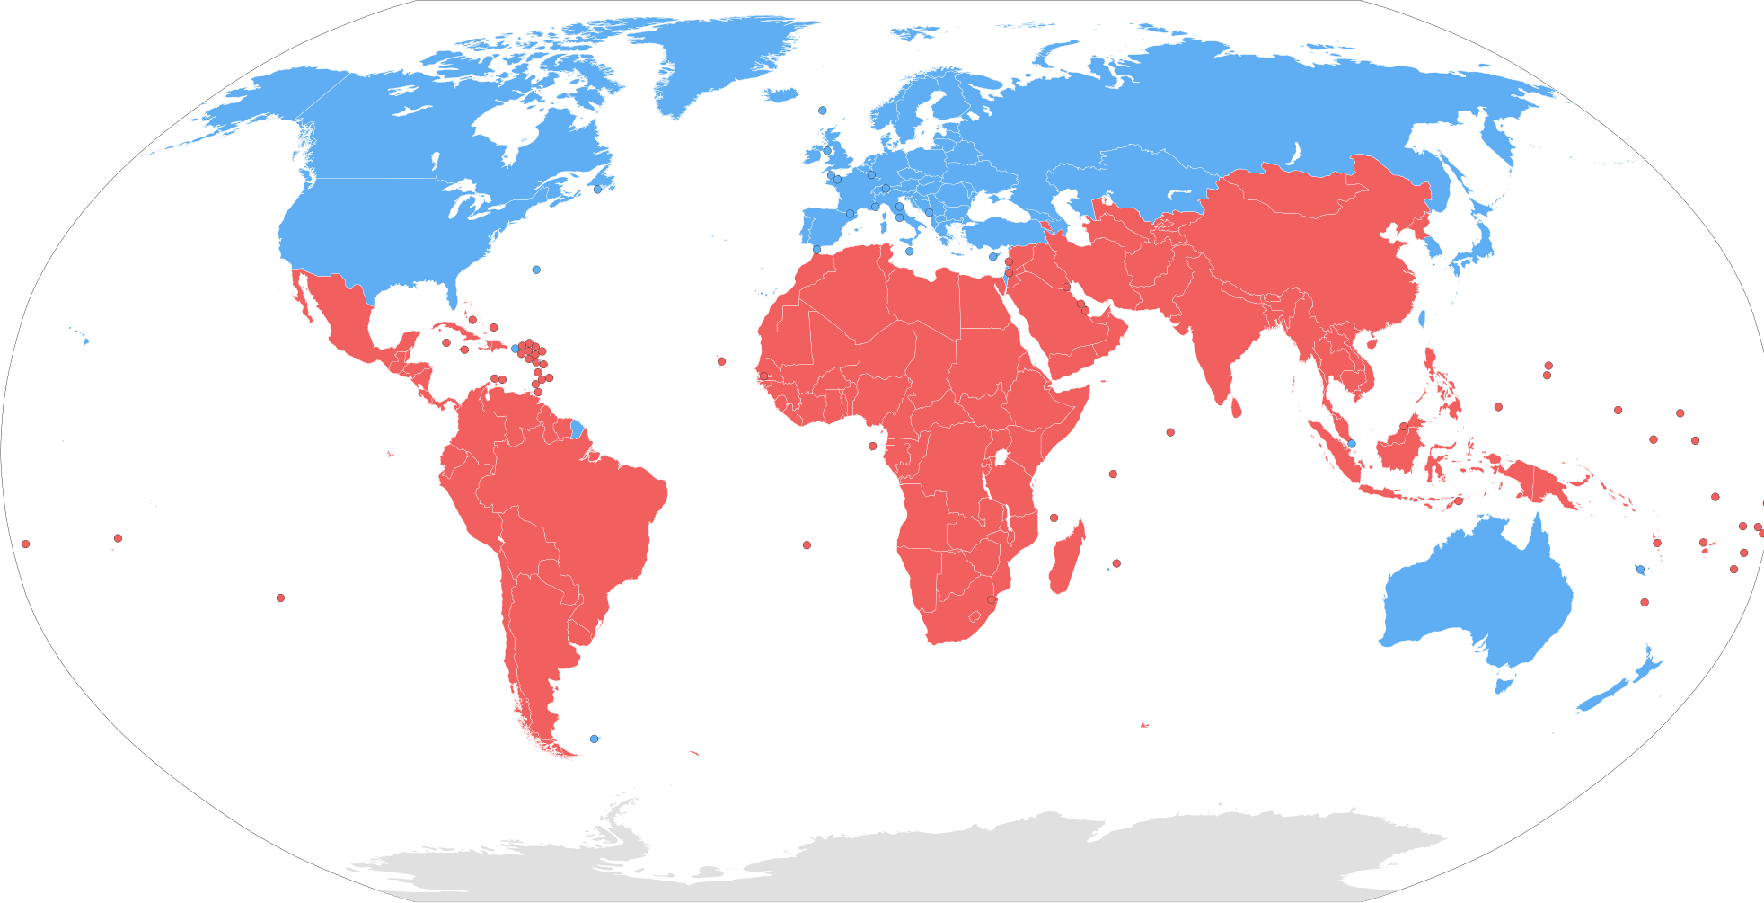

Slide 3
Global North
Global South
United States
Canada
Japan
Europe
South Korea
Singapore
Australia
New Zealand
Most countries
are in Asia and Africa, Latin America.
Philippines
Malaysia
Haiti
China
Lebanon
Chad
Brazil
Notes:
Put country lists here

Slide 5
Global South
It references an entire history of colonialism, neo-imperialism, and differential economic and social change through which large inequalities in living standards, life expectancy, and access to resources are maintained.

Slide 6
Global South
Developing countries
¾ quarters of the world population
Mainly agrarian economies in Africa, India, China, and Latin America
Not as economically sound and politically stable
Tend to be characterized by turmoil, war, conflict, poverty, anarchy and tyranny
Notes:
Characteristcs and such

Slide 7
Global North
1/4 quarter of the world population
Developed societies of Europe and North America
Established democracy
Wealth
Technological advancement
Political stability
Aging population
Zero population growth
Dominance of world trade and politics
Notes:
Refrences

Slide 8
Global North
PROBLEMS
OVERCONSUMPTION AND FOOD WASTAGE
WIDESPREAD POVERTY (IRELAND AND UK SPECIFICALLY)
EXPENSIVE HEALTHCARE
INCREASING RATE OF MENTAL HEALTH PROBLEMS
Notes:
PROBLEMS WITH GN
-overconsumption - explains high rate of obesity in america
- high percentage of food wastage in USA and UK
WIDESPREAD POVERTY- Widespread growing poverty including child poverty is serious concerns and most people you see on the street are graduates who have gone to school. They are educated and heavily in debt. (student loans)
Expensive medicines - hiv drug in africa is 75usd while it’s 3900usd in us also, not all have health insurance in first world countries
MENTAL HEALTH PROBS- Looking at the lifestyle adopted by “First World”, its designed for Individualistic lifestyle, with less to no interaction within family and community. The emotional needs are fulfilled by increased consumption of goods/products. No one identifies this underlying design, and attributes Mental Health issues to genetics.

Slide 9
Global South
PROBLEMS
Neocolonialism
Labor conditions
Globalization, global health governance, health, and prevention needs
Market liberalization
Notes:
The problems with GS
-contemporary global capitalism
-neocolonialismq`
Global South captures a deterritorialized geography of capitalism’s externalities and means to account for subjugated peoples within the borders of wealthier countries, such that there are economic Souths in the geographic North and Norths in the geographic South.
Following independence and decolonization, these states had dire need of new infrastructure and economic stimulation. Many relied on investment from foreign countries. This funding focused on improving infrastructure and industry, but led to a system of systemic exploitation. They sold raw materials, like as rubber, for a bargain. In return, Western countries used cheap labor in the Global South for production.The West benefited significantly from this system, but left the Global South undeveloped. This system of exploitation is called Neocolonialism. A
-contractualization
-lack of health facilities
MARKET LIBERALIZATION LOSE COMPETITION IN THE NORTH EX: global brands/companies are reffered rathen than the other ex: cars: subaru, kia, nissan // ford chevrolet toyota

Slide 10
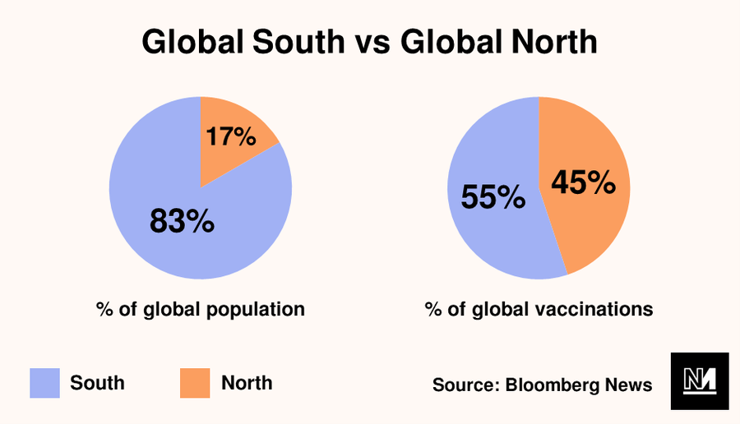

Slide 11
The world has change
Unipolar vs. Multipolar
https://www.youtube.com/watch?v=ufAHg6hN4OA&list=PPSV
Notes:
Defining development
History
Where it starts??

Slide 14
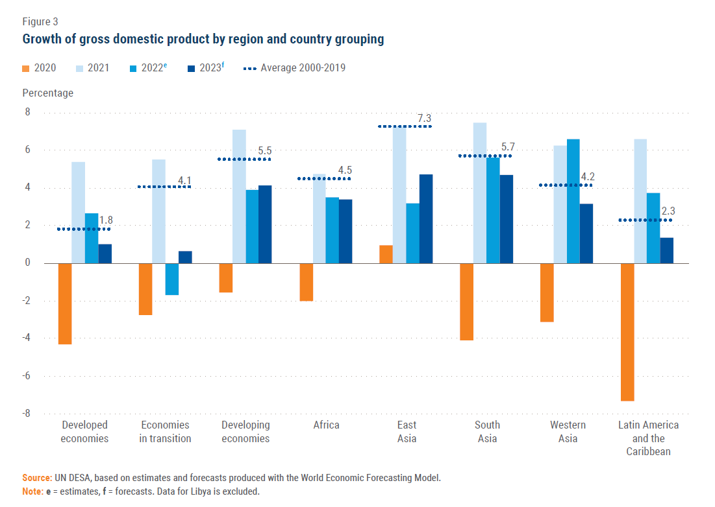

Slide 15
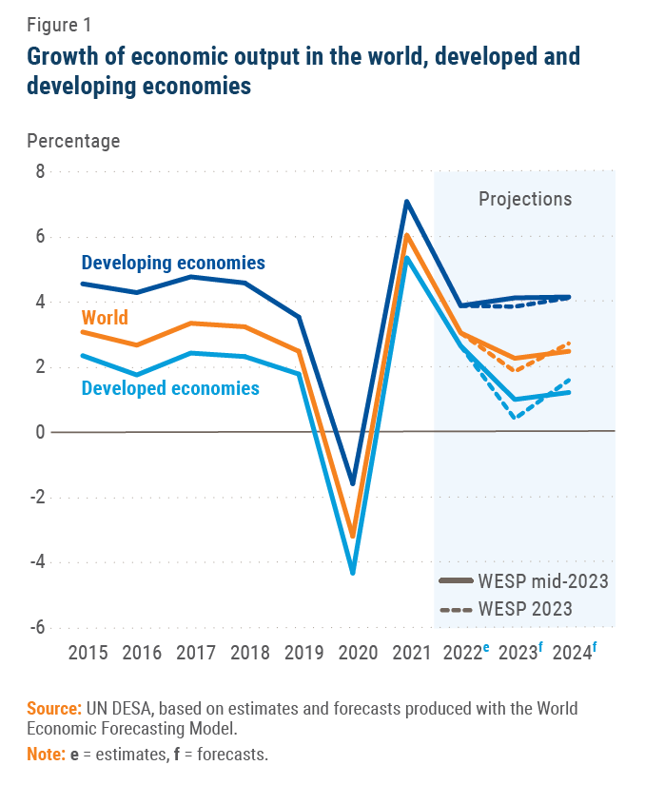

Slide 16
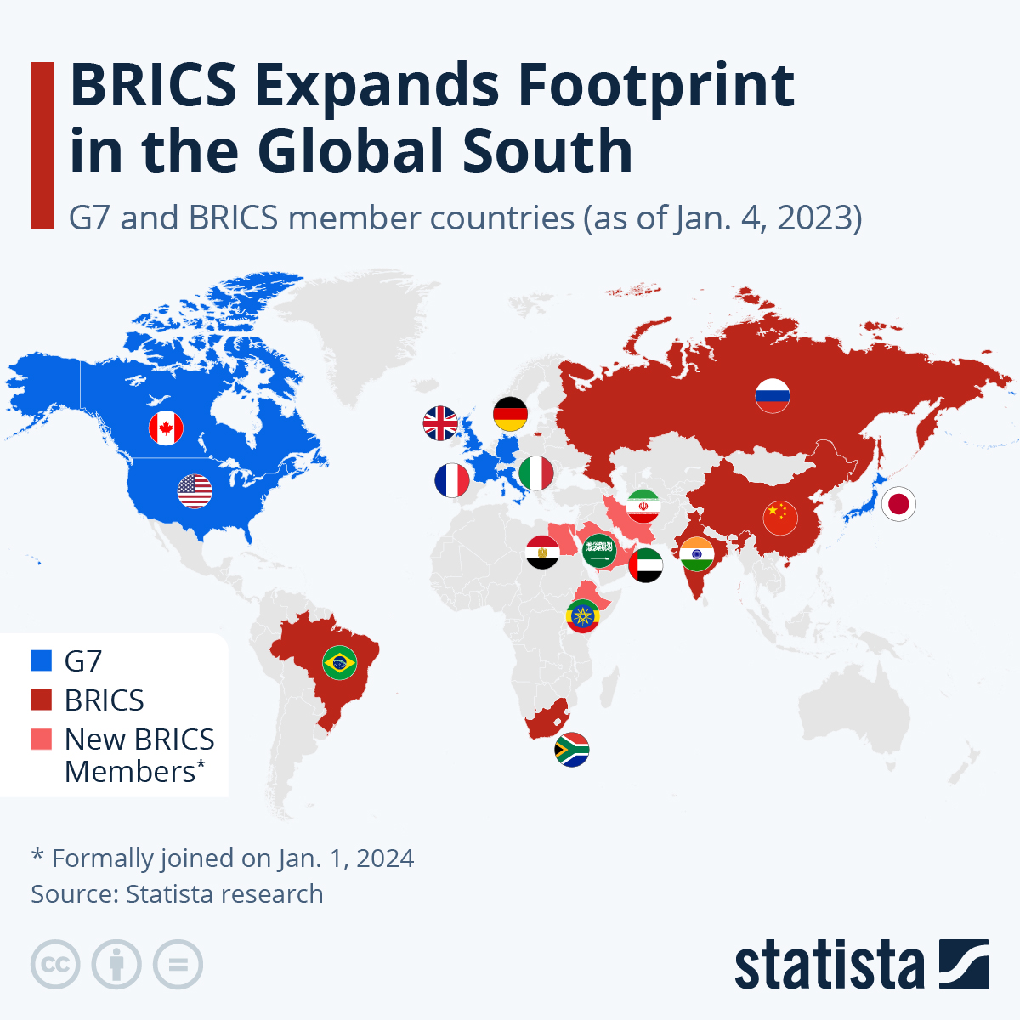

Slide 17
South Global (BRICS) Entrepreneurship Data
‘TEA’ and ‘entrepreneurial intentions rate’ are highest in Brazil and smallest in Russia.
Russia has the greatest ‘fear of failure rate’ (43.83%), South Africa has the smallest (33.01%).
38.24% aged 18–64 cannot create businesses due to fear of failure.
42.92%, aged 18–64 believe they have the skills and knowledge to start a business.
The ‘perceived opportunities rate’ is greatest in India (54.36%) and smallest in Russia (23.09%).

Slide 18
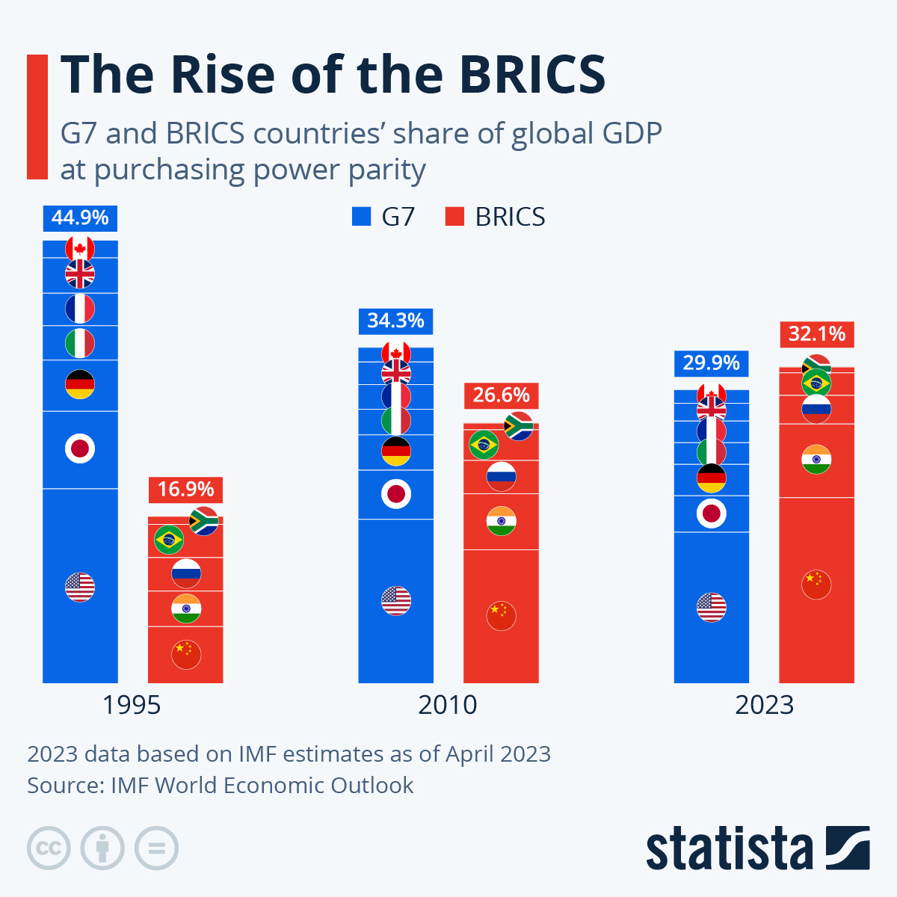

Slide 19
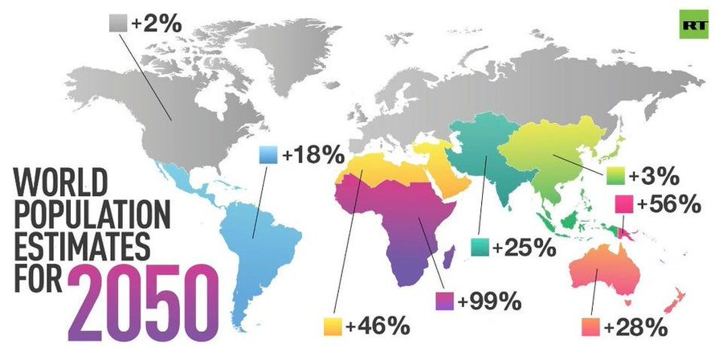

Slide 20
LATEST NEWS
https://www.ft.com/content/03cb69bf-2c55-497d-ad07-2ca40ec6bfcd
https://www.gob.mx/sre/prensa/mexico-and-brazil-reaffirm-strategic-relationship-with-bilateral-cooperation-agreements
https://www.reuters.com/world/china-colombia-sign-belt-road-cooperation-pact-2025-05-14/

Slide 21
LATAM R&D Investment
Latin America and the Caribbean (LAC), in turn, have seen their share decline from 3% to 2% between 2000 and 2023.
In Latin America, Brazil, the region’s largest contributor, fall from 2% in 2000 to 1.3% in 2023. Argentina and Mexico also experienced declines. (WIPO, 2024)
LATAM Productivity
In 1960, LAC’s GDP per worker was 35% of U.S. levels. By 2019, it had dropped to 28%.
Between 1995–2019, LAC averaged 0.8% annual productivity growth, while OECD countries grew at 1.7%.
From 2015–2019, productivity growth in LAC slowed to just 0.3% per year, the lowest of any global region.

Slide 22
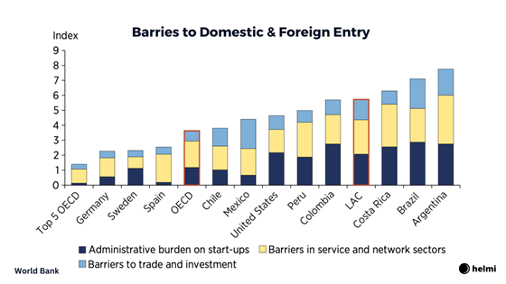
In LAC, the top 4 firms in a given market capture 60% of total sales, compared to 40% in the OECD.
In Brazil and Peru, market concentration ranks among the highest in the world.
From 2005 to 2015, concentration increased in 10 of 11 LAC countries. In contrast, it decreased in most OECD countries.
High market concentration reduces pressure to innovate or invest in efficiency.

Slide 23
Ways to increase SME’s productivity
Economic growth coupled with technological innovation will boost the productivity of economic enterprises and increase people’s welfare.
Government policies
Business capital support
Human resource capacity
Strengthening simultaneously have a positive effect on the development of SMEs

Slide 24
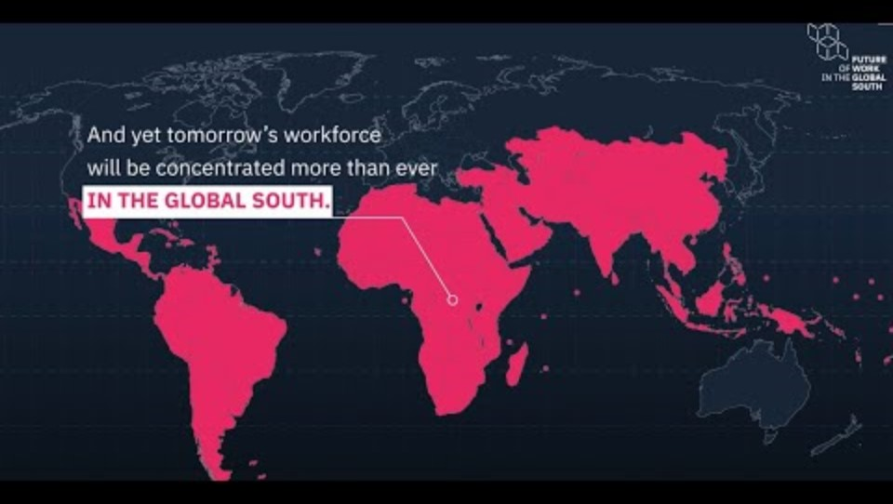
Muchas Gracias

Slide 25
Book
Editors:
Oscar Javier Montiel Mendez (UACJ)
Rosa Azalea Canales Garcia (UAEMEX)
Anel Flores Novelo (UADY)
Duncan Pelly (Fisk University)
Profile:
11 countries
51 researchers
26 universities
24 Chapters
Entrepreneurship and Reflexivity: Critical Visions from the Global South (Palgrave Macmillan), Forthcoming, August 2025.

Slide 26
oscar.montiel@uacj.mx

