Slide 1

Dia Mundial del Emprendimiento, UAEMEX:
“Handbook of Entrepreneurship in Latin America: Unleashing a millennial potential” (Emerald Publishing, UK)
Speakers:
Oscar Javier Montiel Mendez
Universidad Autónoma de Ciudad Juarez
Abril, 2024

Slide 2

Agenda:
Background
Context
Table of contents
Conclusions

Slide 3
Background:
Economics Literature:
Knight (1921), entrepreneurship as decision-making about the use of heterogeneous resources under uncertainty (actions, not opportunities).
Schumpeter’s Innovation (1934) and The Entrepreneur (1939), “Creative Destruction”.
Kirzner’s Competition and Entrepreneurship (1973; “Entrepreneurial Discovery”), underlies in the opportunity-discovery of modern entrepreneurship (Shane & Venkataraman 2000).
Lachmann’s (1976) “Entrepreneurial Creation”, a continuous recombinative process, how entrepreneurial action at the individual and organizational levels takes place.

Slide 4


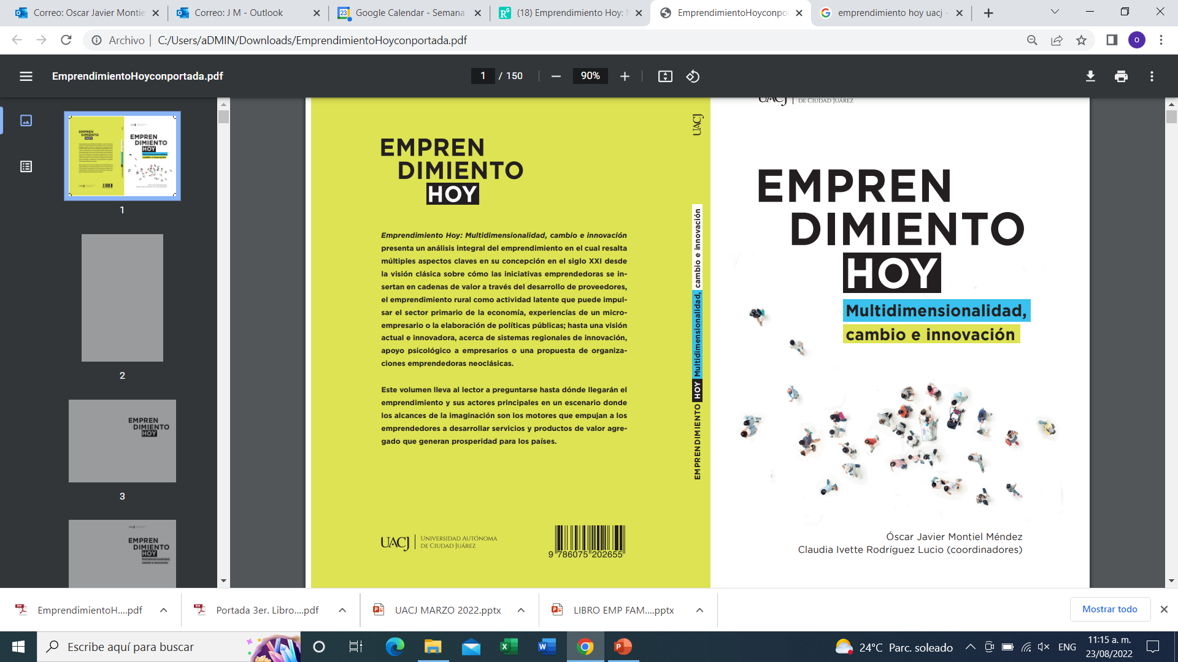

Slide 5
"We only reviewed papers written in English. One
reason for doing this is that theory in
entrepreneurship originated in North America
and Europe, two regions that have positioned
themselves at the research frontier and have
relatively mature research findings. Another reason
is that English is popular in academia and papers
published in English can easily circulate in different
countries" (Lu, Lu, Lv, Huang, Li, Jian, and Eve, 2020)
Lu, Ren; Lu, Qu; Lv, Daguo; Huang, Yuxiang; Li, Shuping; Jian, Ze and Reve, Torger. (2020). The evolution process of entrepreneurship studies in the 21st century: research insights from top business and economics journals. Journal of Economic Surveys, 34(4), United States (Pp.922-951).

Slide 6
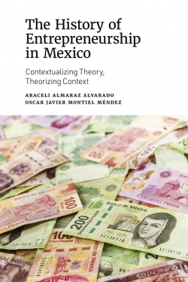
2018-2020
https://books.emeraldinsight.com/page/detail/The-History-of-Entrepreneurship-in-Mexico/?k=9781839091728

Slide 7
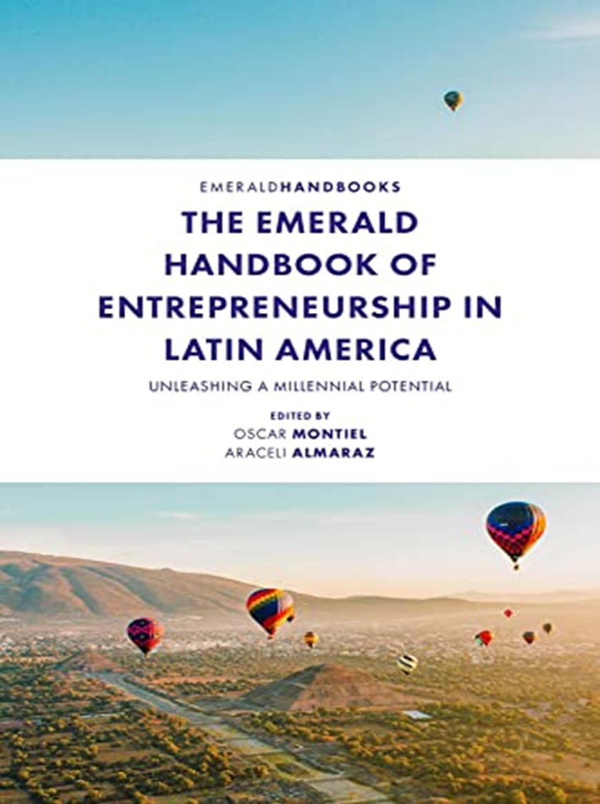
Context
https://www.amazon.com/Emerald-Handbook-Entrepreneurship-Latin-America-ebook/dp/B09QKS59VR/ref=sr_1_1?keywords=handbook+entrepreneurship+latin+america&qid=1647194972&sr=8-1
Contributions from nearly 45 researchers across and outside Latin America, contains the most important debates on creativity, innovation, and entrepreneurship in Latin America.
Covering the most recent topics that influence Latin America’s entrepreneurial dynamics, chapters are written by specialists from Mexico, Brazil, Canada, Chile, Colombia, England, Venezuela, Spain & Peru.

Slide 8
Handbook’s premises
LATAM’s position:
Our Past to build its Future (multidimensionality)
Historical failure
Reader’s approach to the Handbook
Latin America vs. Western Hemisphere
An important production necessary to debate globally
LATAM’s view:
Eurocentric and predeterminist visions (Indexicality, language and action dependent on context)
Emic vs. Etic
Dilthey’s Historicism (interpretative, particular, perspective, contextual)

Slide 9

Main Editor, Forthcoming Nov 28th, 2022, Emerald Publishing, UK.
Multidimensional views from a global, geopolitical perspective
Colaborators from Italy, Spain, Mexico, Australia, China, Nigeria, Peru, United Kingdom, etc.

Slide 10
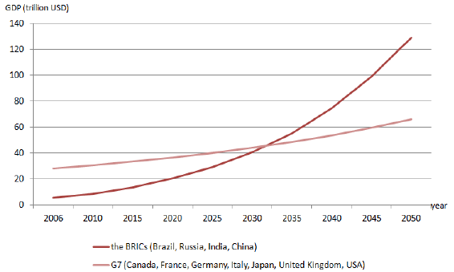
BRICS takes over G7!!

Slide 11
Technology and Innovation in Latin America: The need for a turning point.
Forthcoming, 2024

Slide 12
The Dark Side of Entrepreneurship:
An Exploratory Conceptual Approach*
El lado oscuro del emprendimiento: un enfoque conceptual exploratorio
Oscar Javier Montiel Méndez**, Mark Clark*** y María Guadalupe Calderón Martínez****

Slide 14
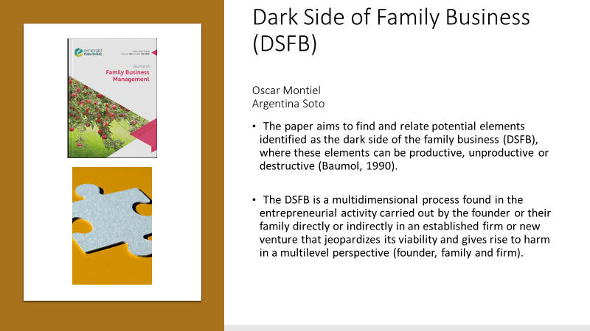

Slide 15
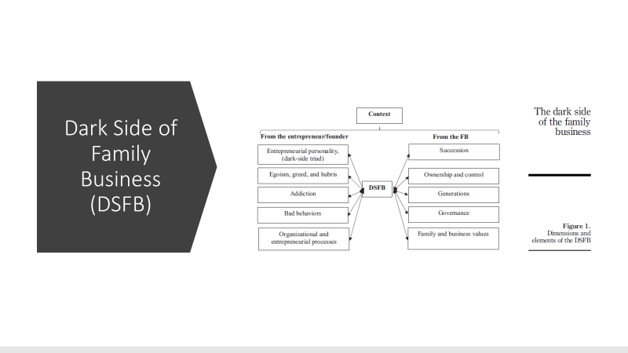

Slide 16
Failed entrepreneurship in a
heterotopia: the story of
Villa Ahumada
Oscar Montiel
Duncan Pelly

Slide 17
Montiel Mendez O. J., Canales García R. A., Gardea Morales O. H. (2023). Entrepreneurial Iatrogenesis: An Exploratory Approach,
13(1), 113-125.

Slide 18
Dark Side of Institutional
Entrepreneurship in Latin
America: Vistas from
Reflexivity
Oscar Javier Montiel Méndez
Rosa Azalea Canales García
Anel Flores Novelo

Slide 20
Dark Side of Entrepreneurship Education? An Exploration from a Public University in Mexico
Oscar Javier Montiel Mendez
Argentina Soto Maciel
Luisa Cajica Carvalho
Duncan Pelly

Slide 21

Contacts
oscar.montiel@uacj.mx

